Slide 1

Phase 3
Analysis of the effect of parameters on the system

Slide 2

Our team members
Morteza Rashidkhan - 810899055
Shiva Vafadar - 810899074
Hossein Shahidi - 810899057
Amirhossein Shaneghi - 810899056

Slide 3
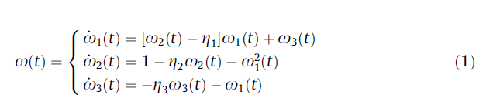
Chaotic dynamics of the finance model
At first, we plot the time response for different parameters for our Chaotic system, shown in equation (1), and examine the influence of its parameters. After that, we do this for our proposed system again.

Slide 4
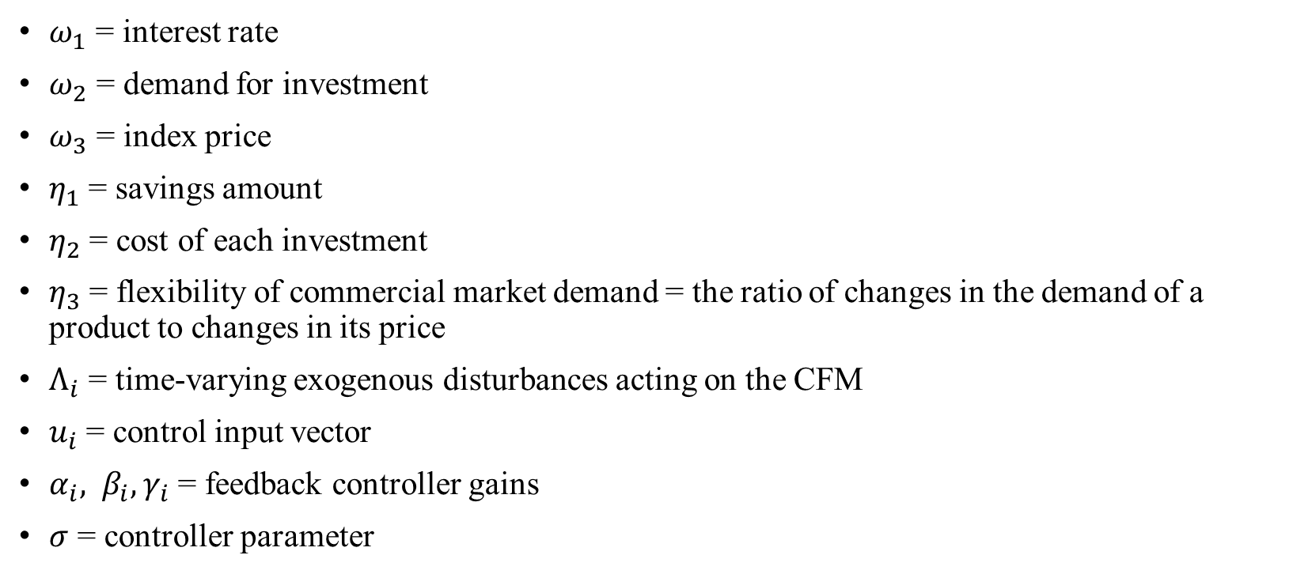
Parameters Definitions
$ω_{1}$ = interest rate
$ω_{2}$ = demand for investment
$ω_{3}$ = index price
$η_{1}$ = savings amount
$η_{2}$ = cost of each investment
$η_{3}$ = flexibility of commercial market demand = the ratio of changes in the demand of a product to changes in its price
$Λ_{i}$ = time-varying exogenous disturbances acting on the CFM
$u_{i}$ = control input vector
$α_{i}, β_{i}, γ_{i}$ = feedback controller gains
$σ$ = controller parameter

Slide 5
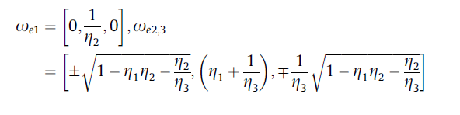
Fixed Points

Slide 6
Impact of the parameter n₁
Initial conditions: w₁(0) = -0.5, W₂(0) = 1.5, W₃(0) = 1;
n₁ = 0.5, n₂ = 0.2, n₃ = 1.5
Fixed points =
[0, 5, 0] ,
[sqrt(0.87 - 0.2n₁), n₁+ 0.6667, -0.6667sqrt(0.87 - 0.2n₁)],
[-sqrt(0.87 - 0.2n₁), n₁+ 0.6667, 0.6667sqrt(0.87 - 0.2n₁)]
All parameters are fixed except n₁. We vary n₁ at each step to observe its effect on the behavior of the system. If we choose n₁ > 4.35, then we have one fixed point. [0, 5, 0]

Slide 7
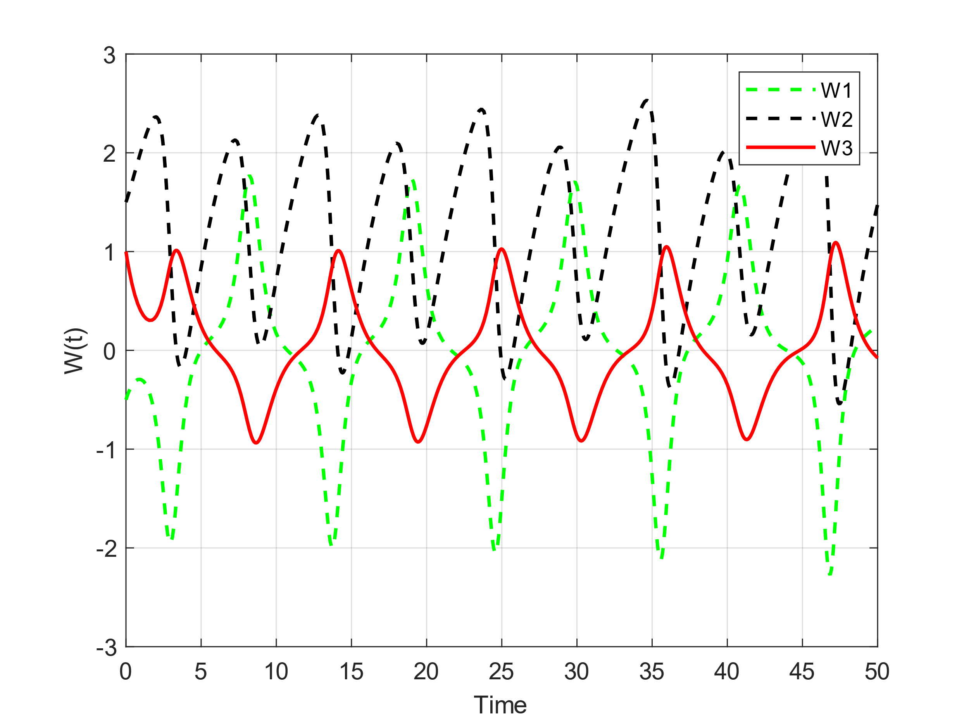
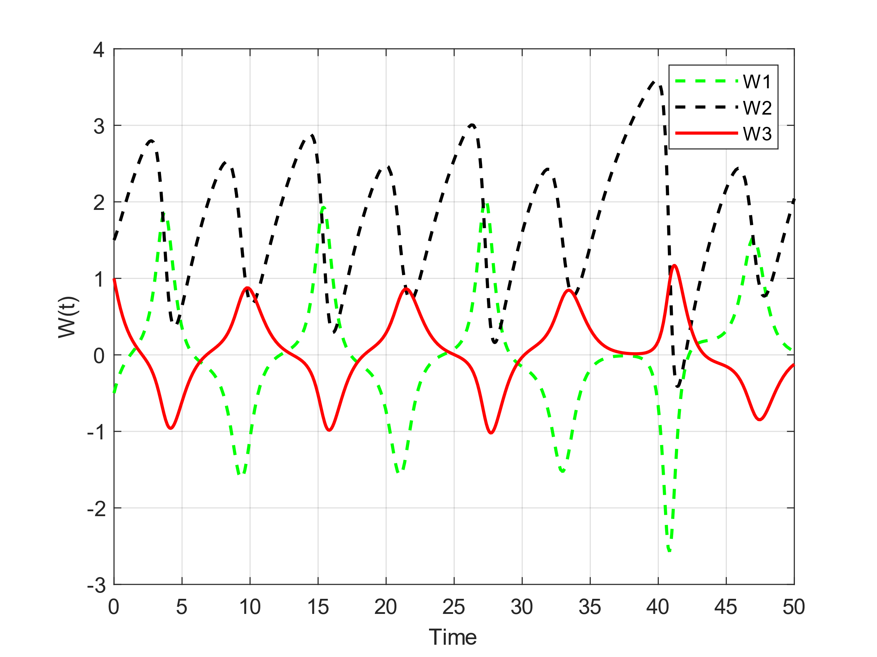
n₁ = 0.5, n₂ = 0.2, n₃ = 1.5
n₁ = 1, n₂ = 0.2, n₃ = 1.5

Slide 8
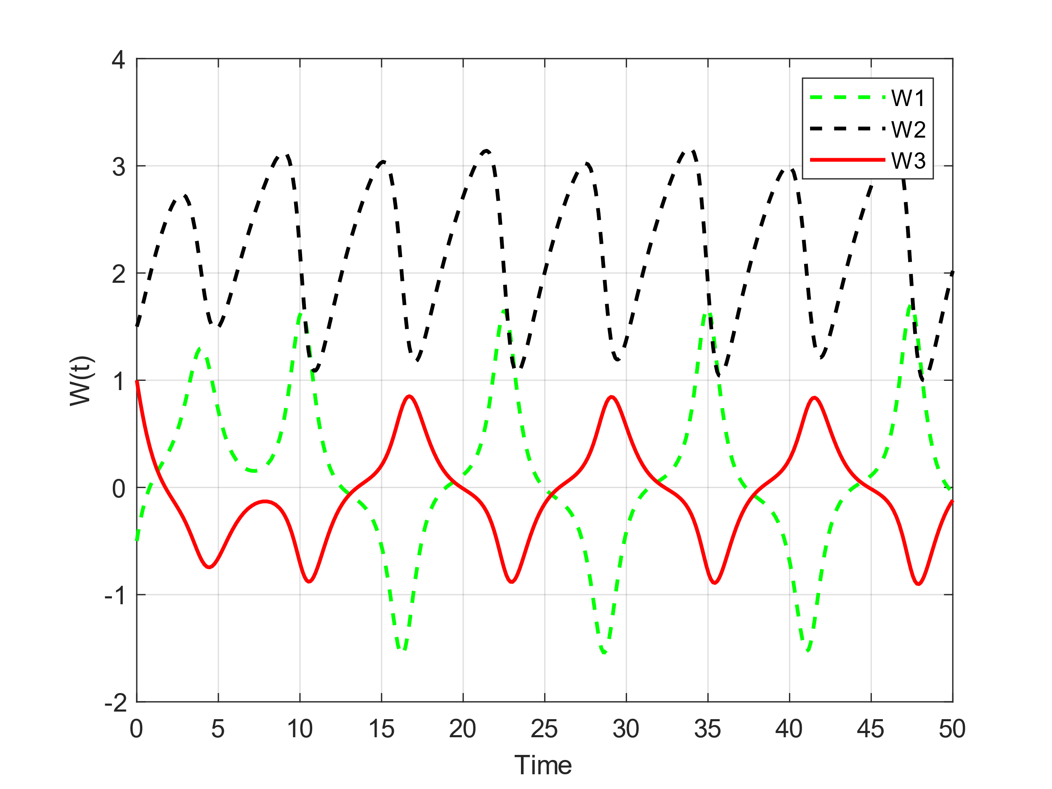
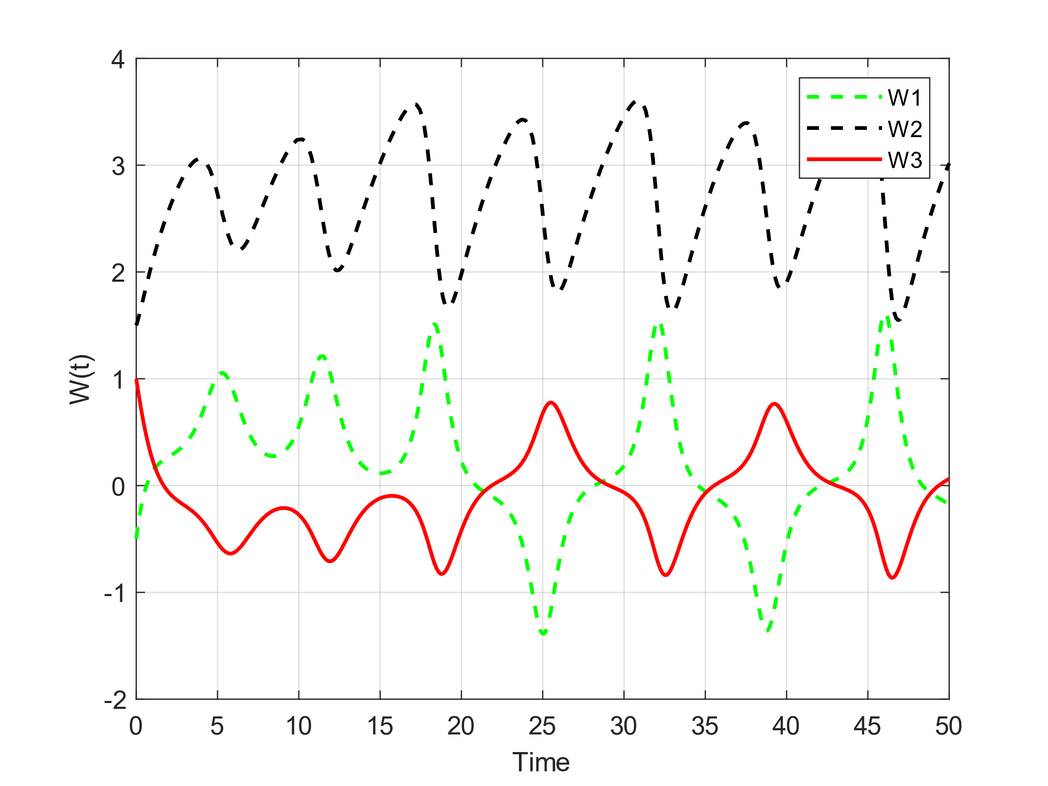
n₁ = 1.5, n₂ = 0.2, n₃ = 1.5
n₁ = 2, n₂ = 0.2, n₃ = 1.5

Slide 9
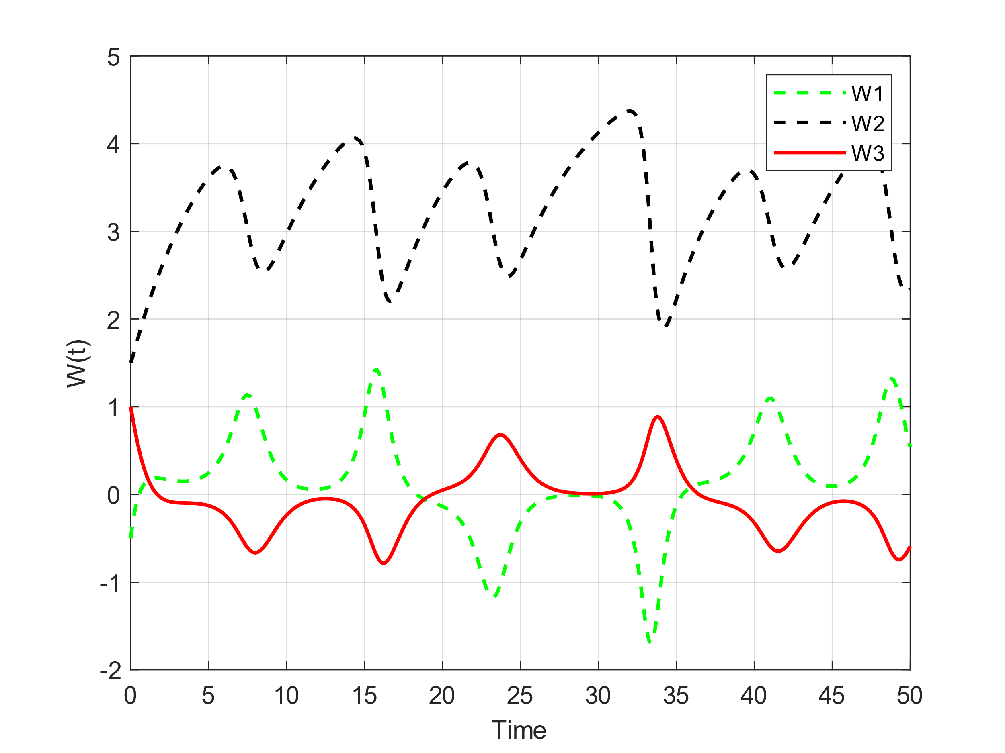
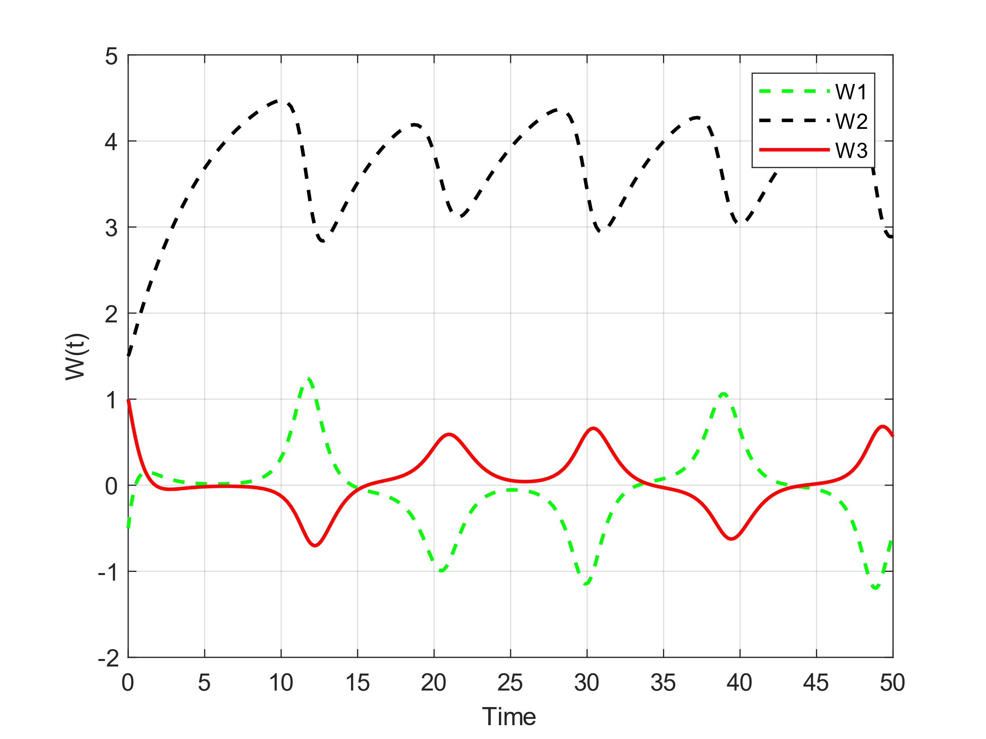
n₁ = 2.5, n₂ = 0.2, n₃ = 1.5
n₁ = 3, n₂ = 0.2, n₃ = 1.5

Slide 10
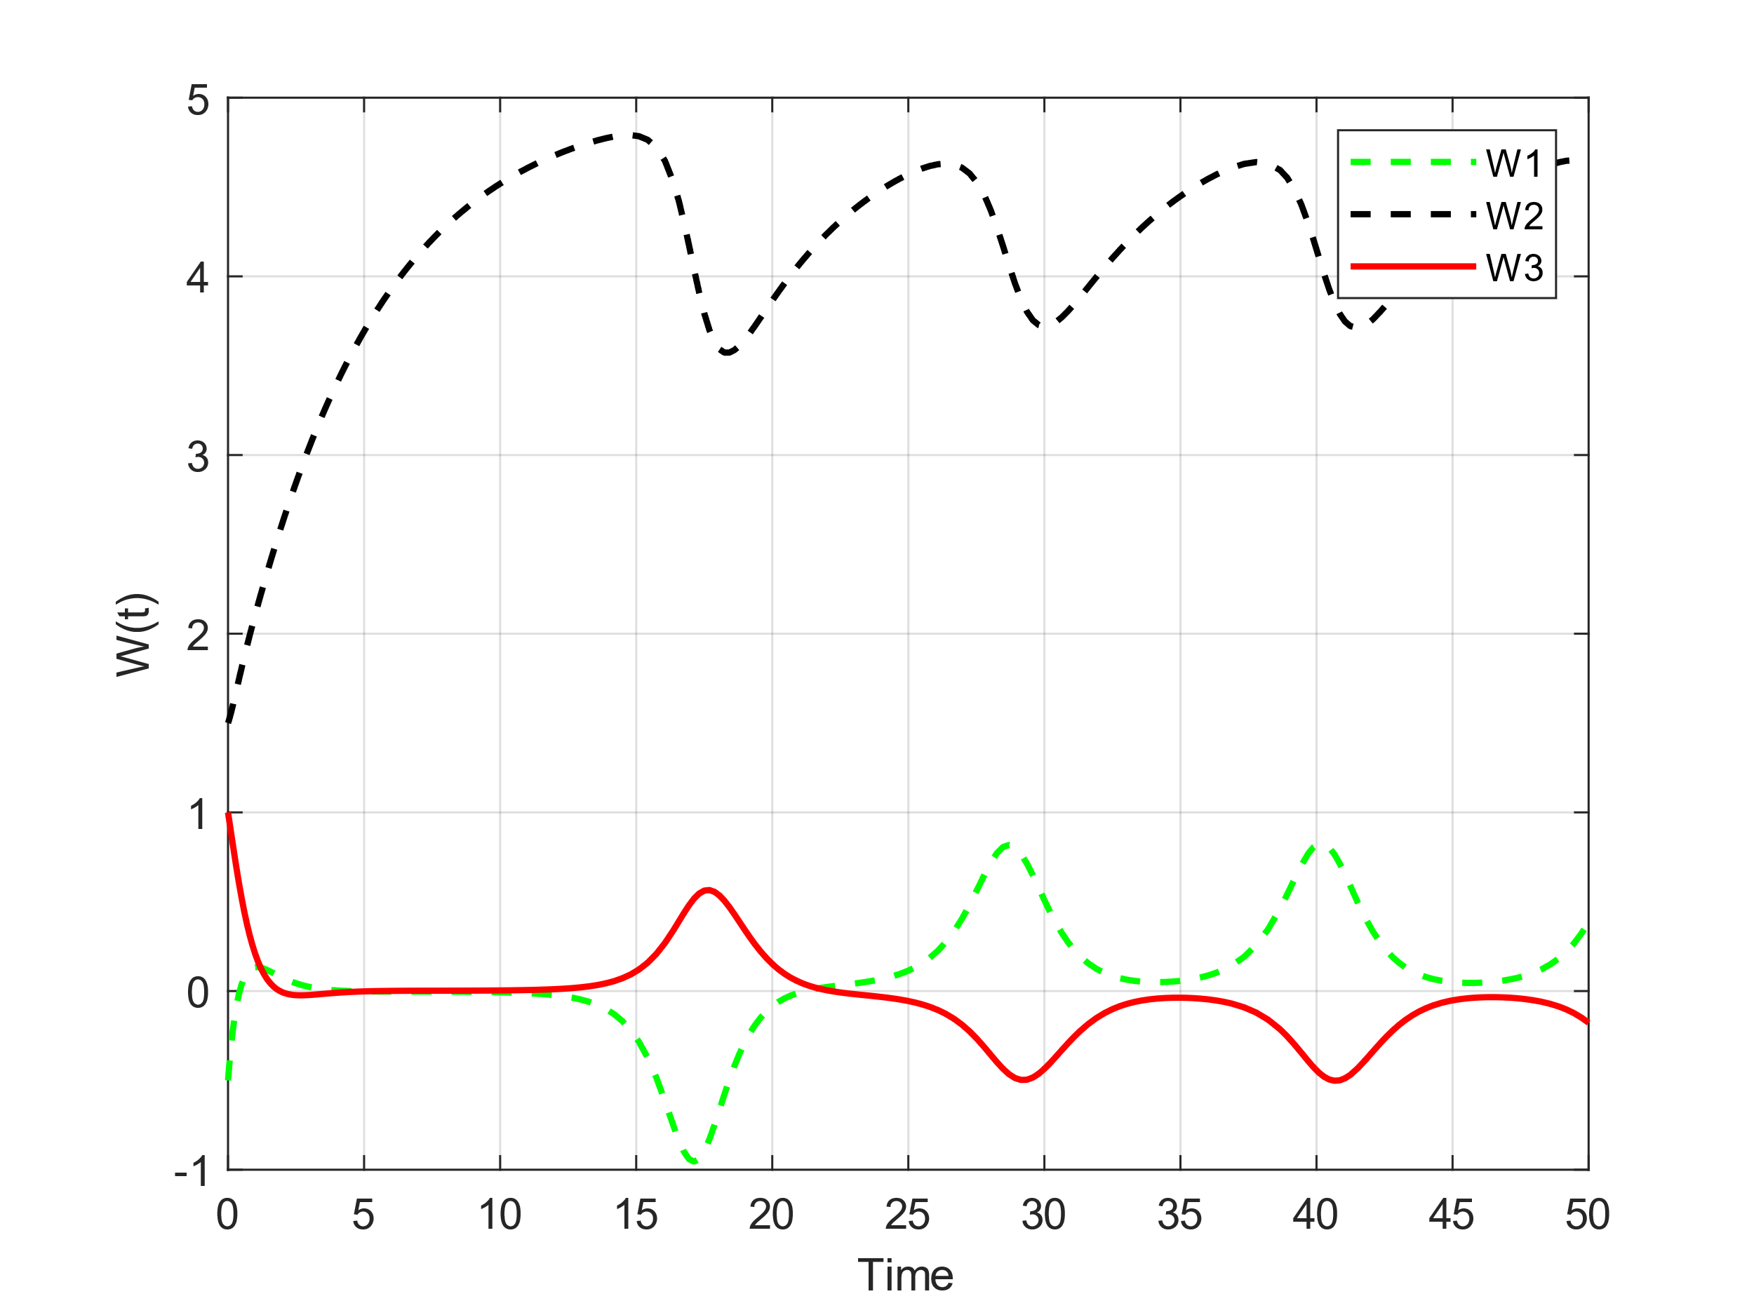
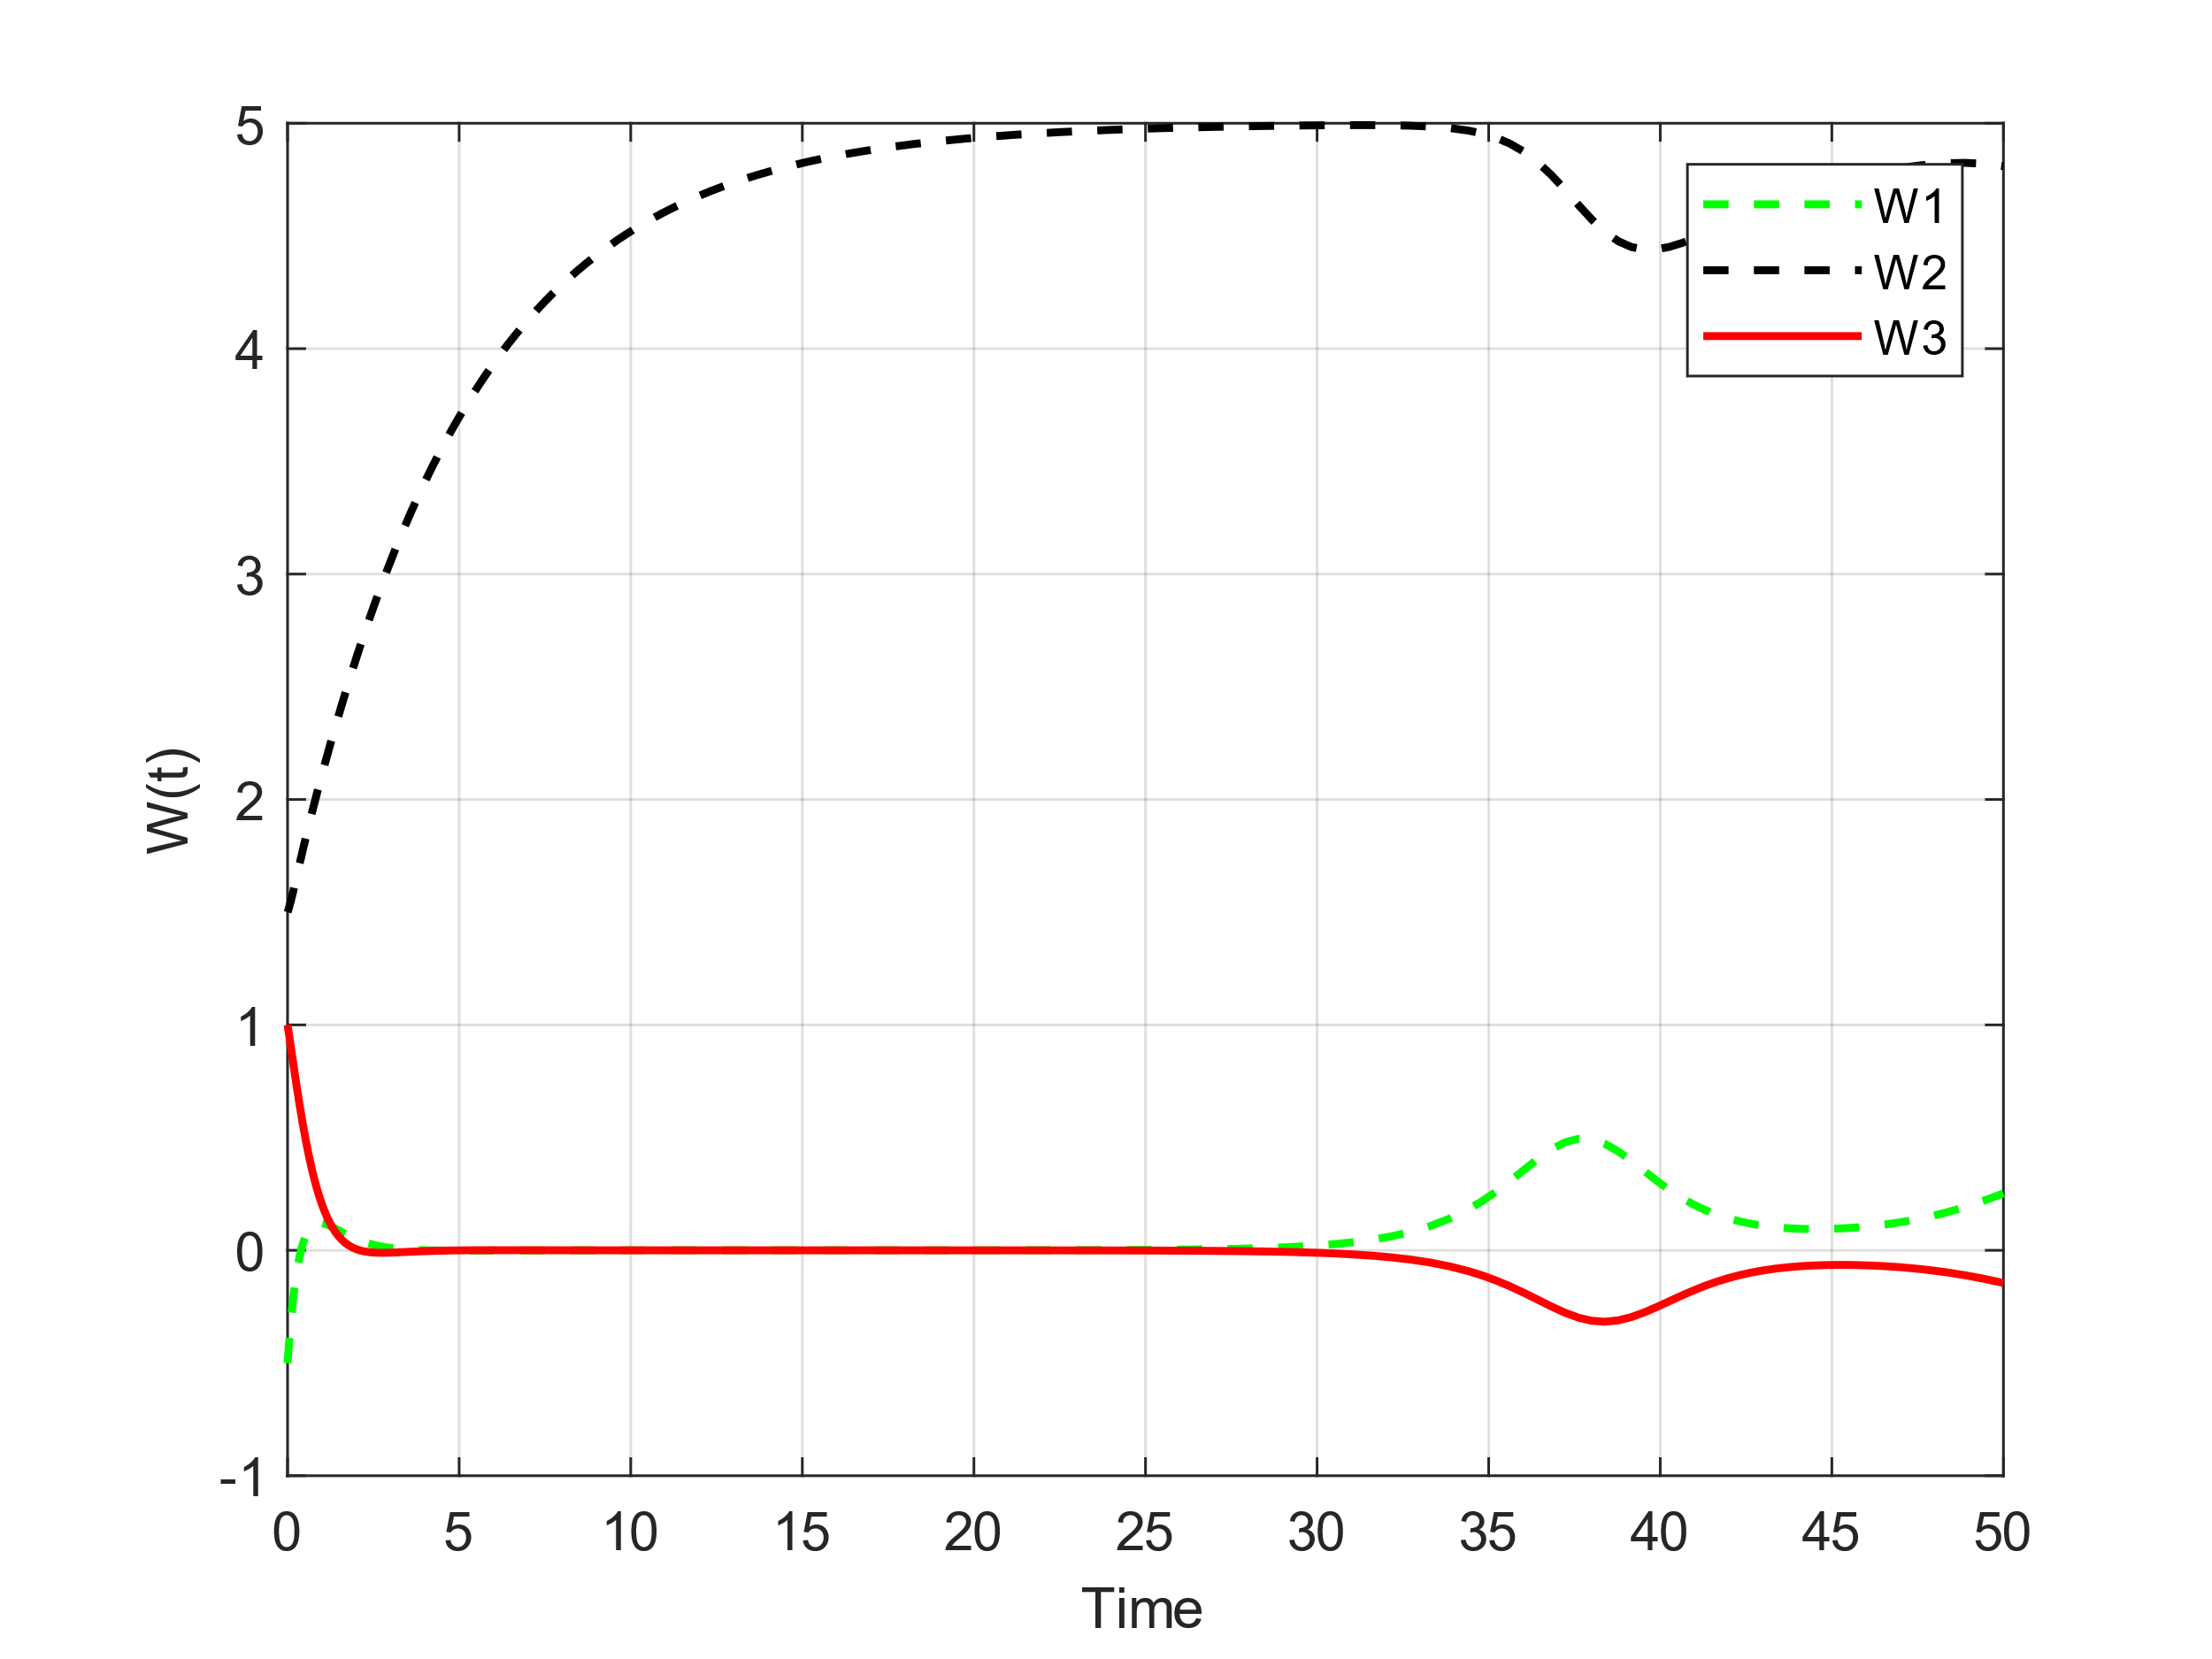
n₁ = 3.5, n₂ = 0.2, n₃ = 1.5
n₁ = 4, n₂ = 0.2, n₃ = 1.5

Slide 11
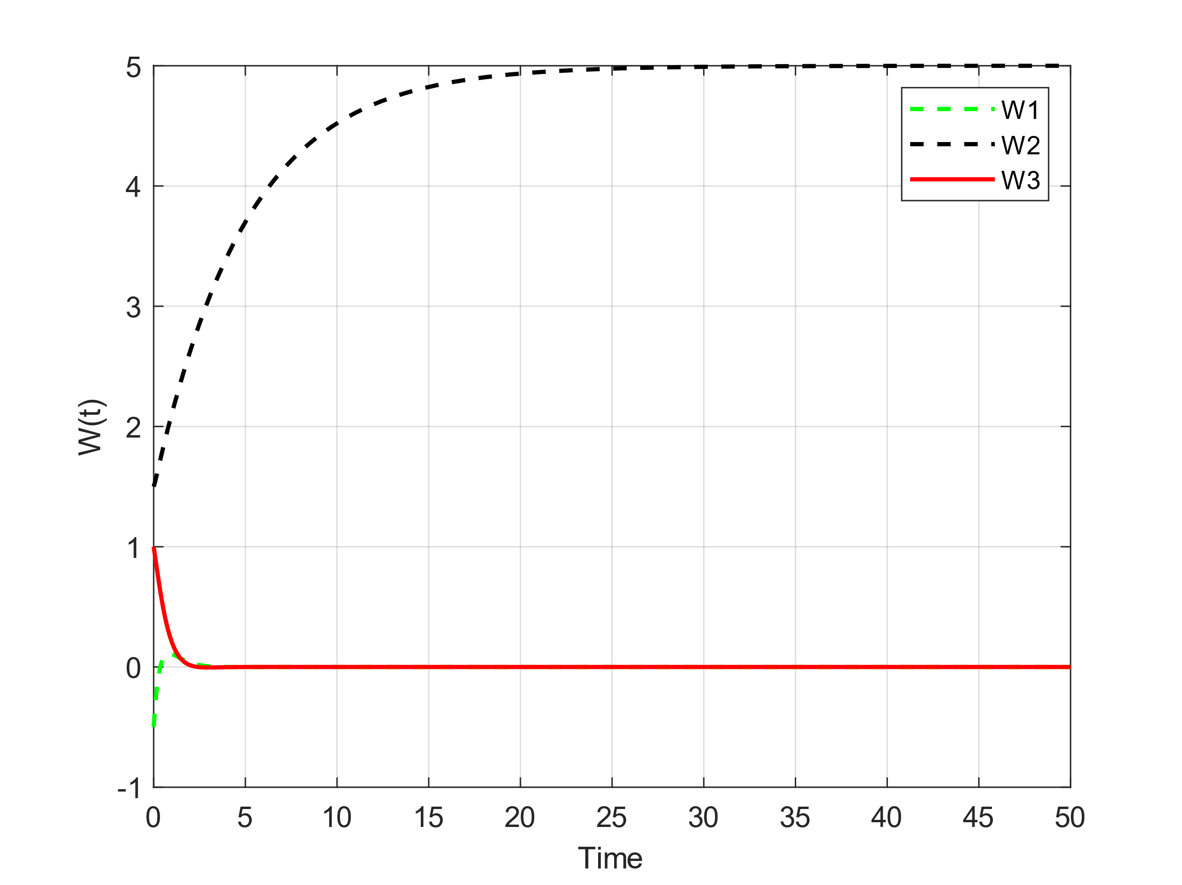

n₁ =4.5, n₂ = 0.2, n₃ = 1.5
n₁ = 5, n₂ = 0.2, n₃ = 1.5

Slide 12
As it can be seen, the system has a limit cycle at small n₁, but as we increase n₁, the range of changes decreases and from some point the system becomes damped (n1 = 3.4) and the more we increase it The rate of damping increases and gradually tends to the fixed point [0, 5, 0], because as we increase n₁, the term under the radical becomes smaller in the other 2 fixed points, and finally, when n₁ is more From 4.37, since the radical becomes negative, these 2 fixed points are removed and only one fixed point [0, 5, 0] remains, which is an absorbing point.

Slide 13
Impact of the parameter n₂
Initial conditions: w₁(0) = -0.5, W₂(0) = 1.5, W₃(0) = 1;
n₁ = 0.5, n₂ = 0.2, n₃ = 1.5
Fixed points =
[0, 1/n₂, 0] ,
[sqrt(1 - 0.5n₂ – n₂/1.5), 0.1667, -0.6667sqrt(1 - 0.5n₂ – n₂/1.5)],
[-sqrt(1 - 0.5n₂ – n₂/1.5), 0.1667, 0.6667sqrt(1 - 0.5n₂ – n₂/1.5)]
All parameters are fixed except n₂. We vary n₂ at each step to observe its effect on the behavior of the system. If we choose n₂ > 0.858, then we have one fixed point. [0, 1/n₂, 0]

Slide 14
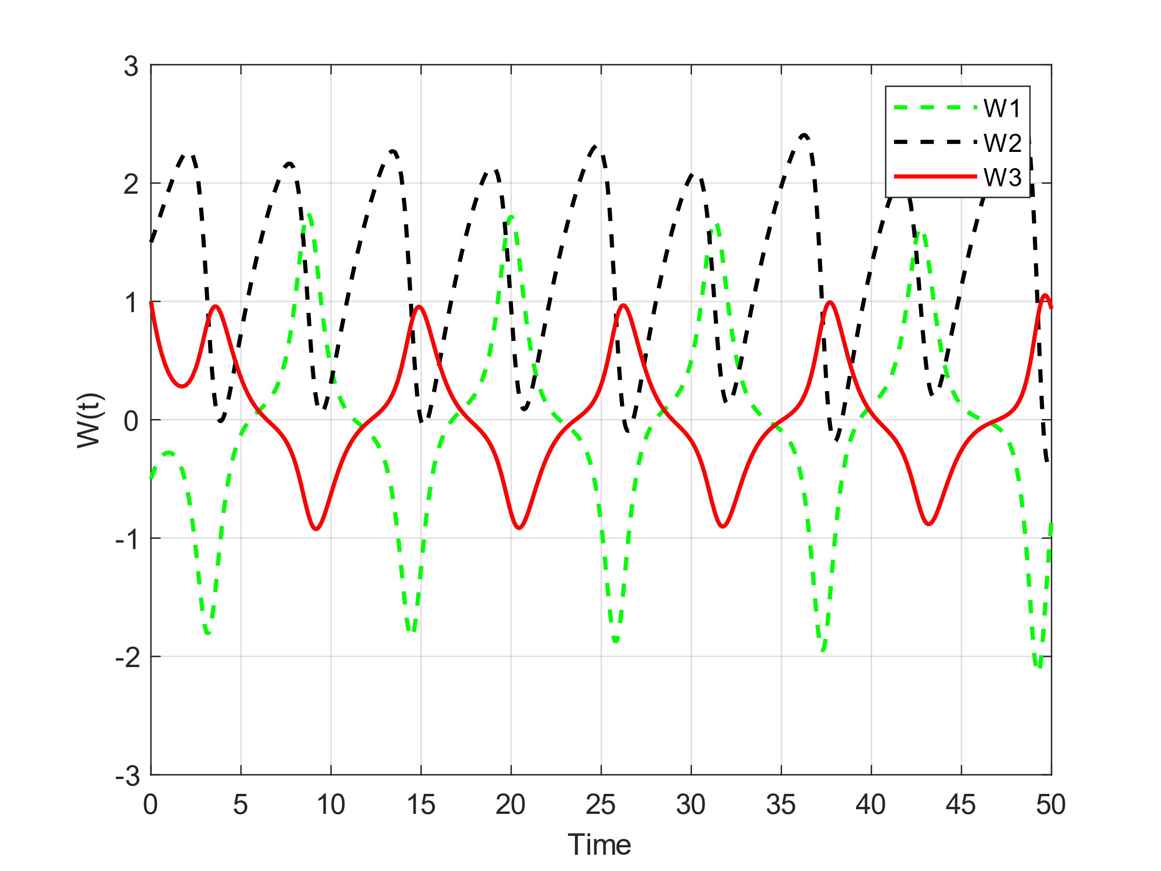
n₁ = 0.5, n₂ = 0.2, n₃ = 1.5
n₁ = 0.5, n₂ = 0.25, n₃ = 1.5

Slide 15
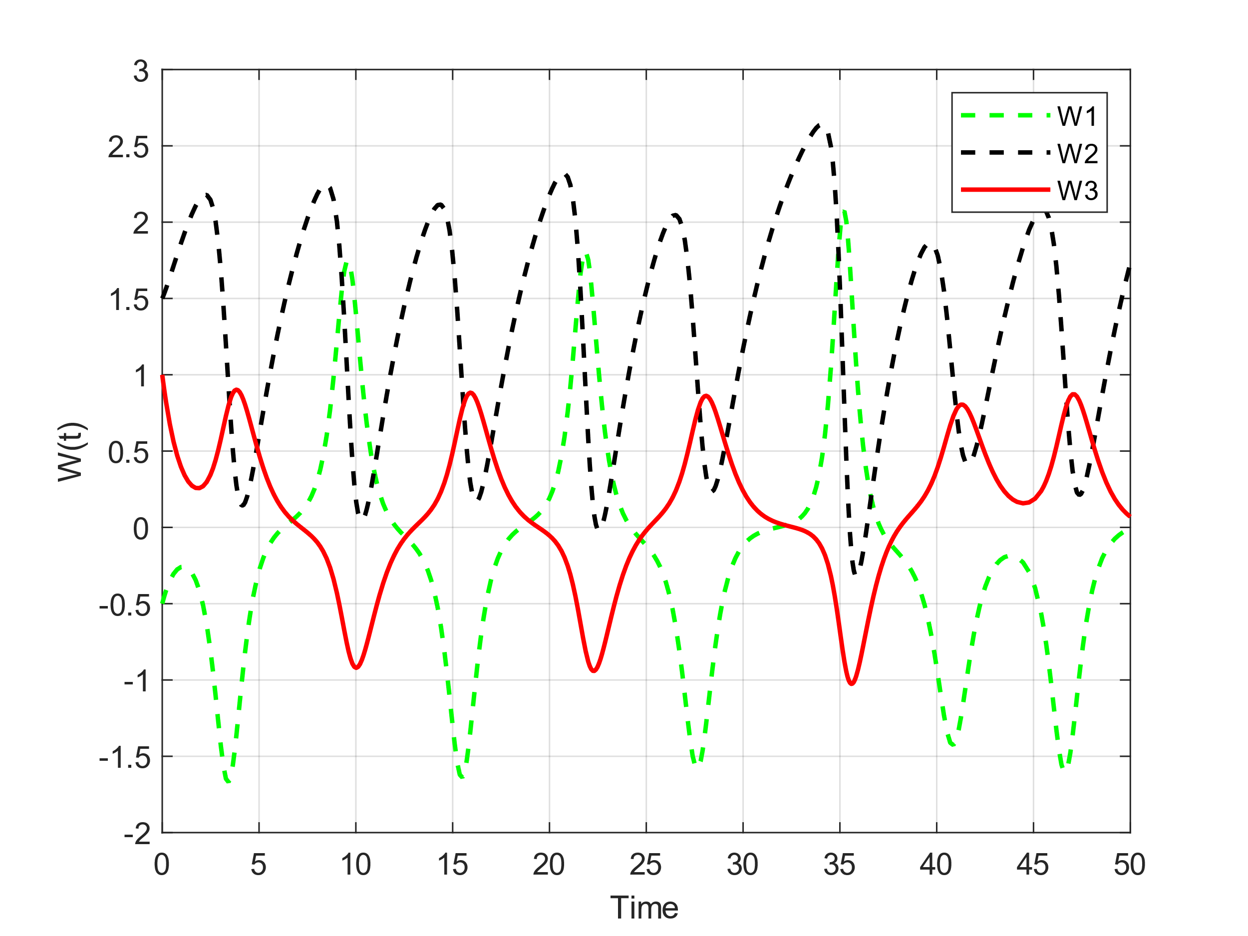
n₁ = 0.5, n₂ = 0.3, n₃ = 1.5
n₁ = 0.5, n₂ = 0.35, n₃ = 1.5

Slide 16
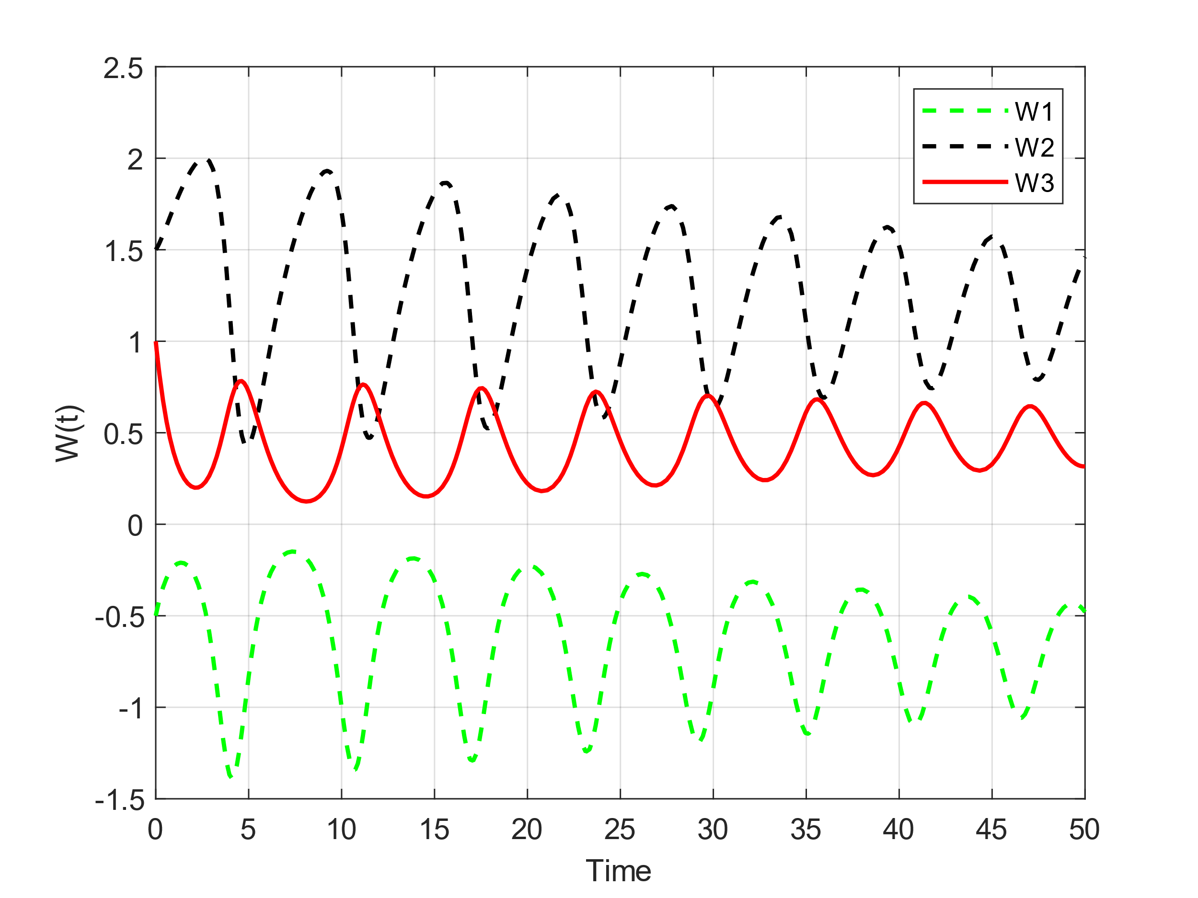
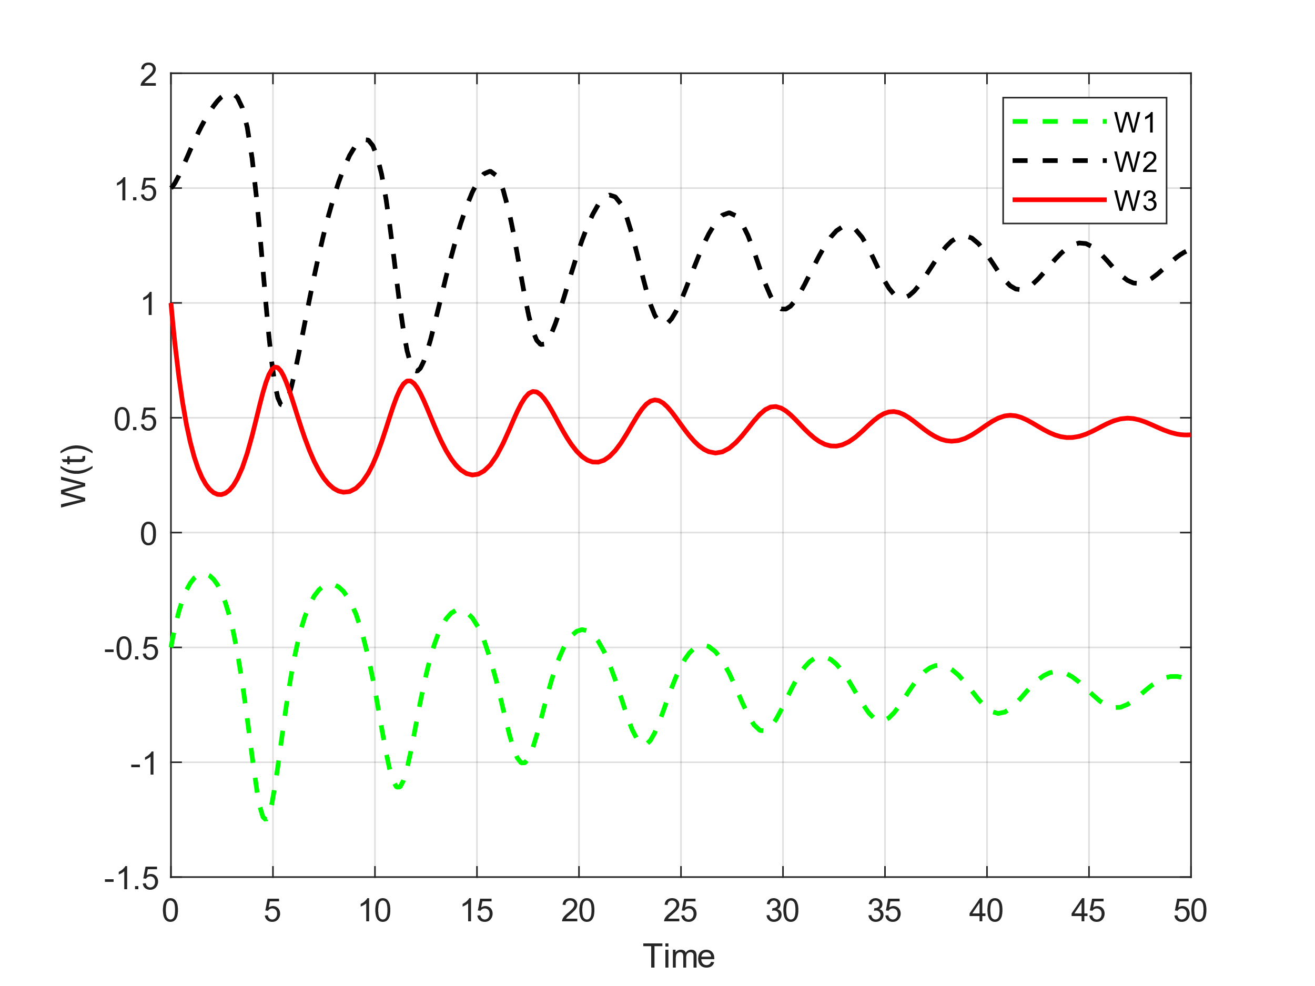
n₁ = 0.5, n₂ = 0.4, n₃ = 1.5
n₁ = 0.5, n₂ = 0.45, n₃ = 1.5

Slide 17
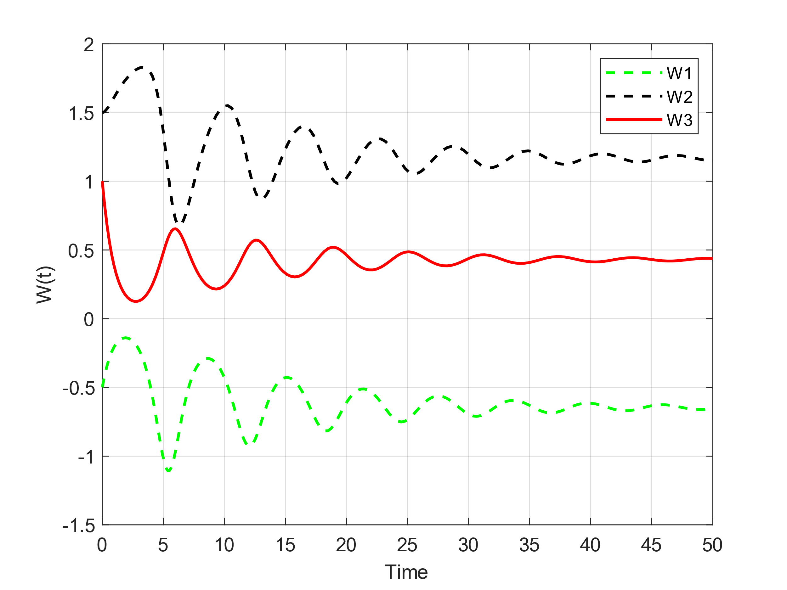
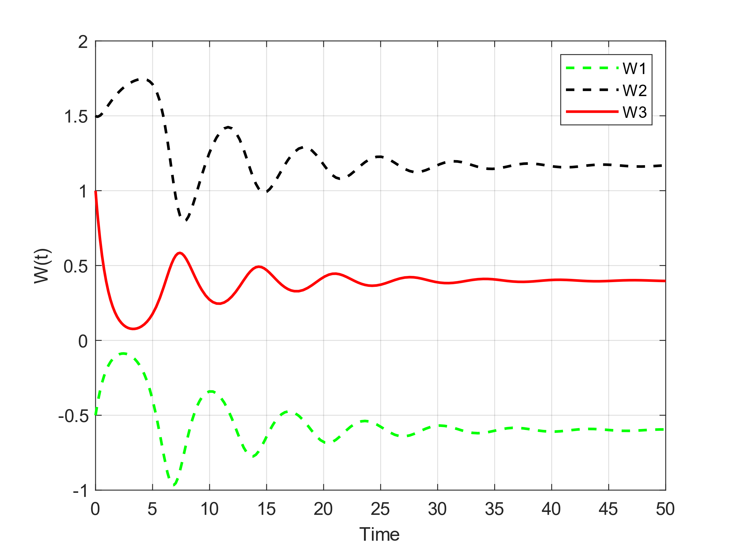
n₁ = 0.5, n₂ = 0.5, n₃ = 1.5
n₁ = 0.5, n₂ = 0.55, n₃ = 1.5

Slide 18
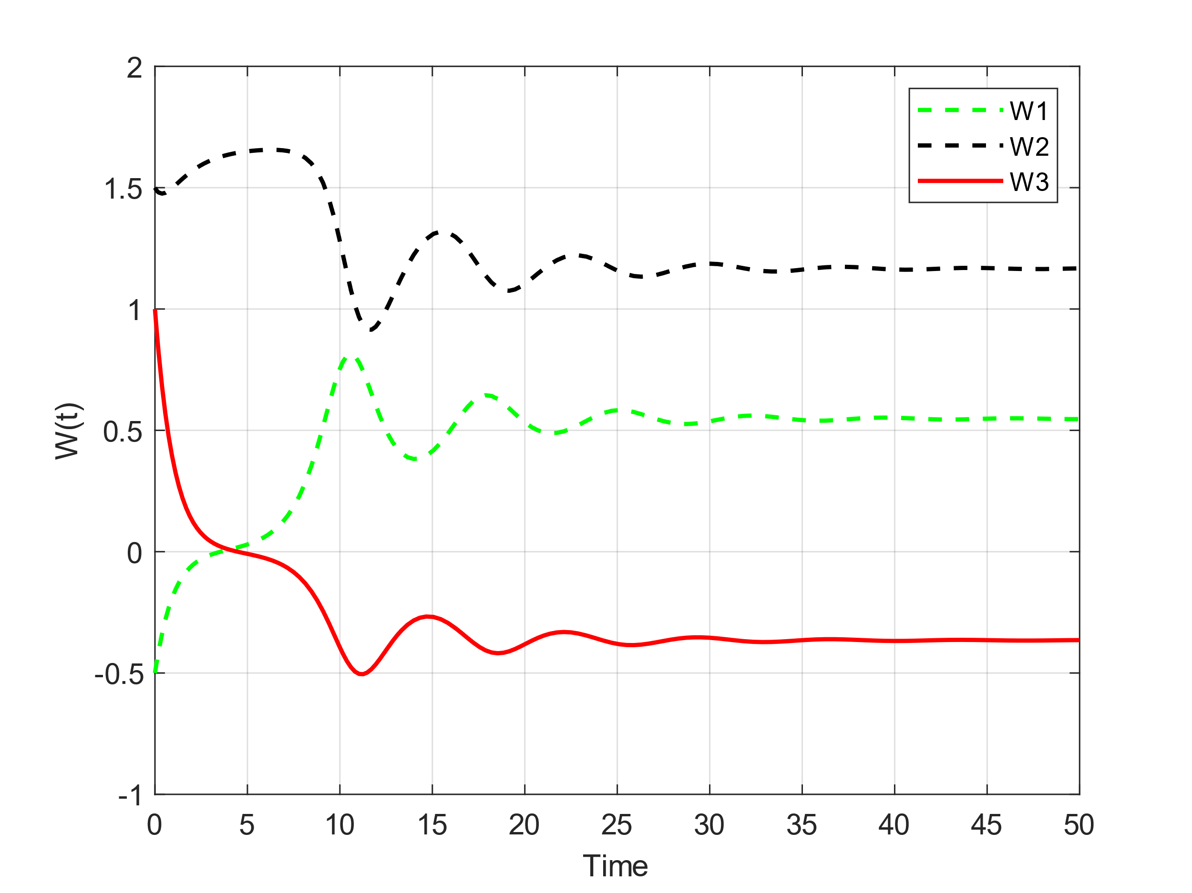
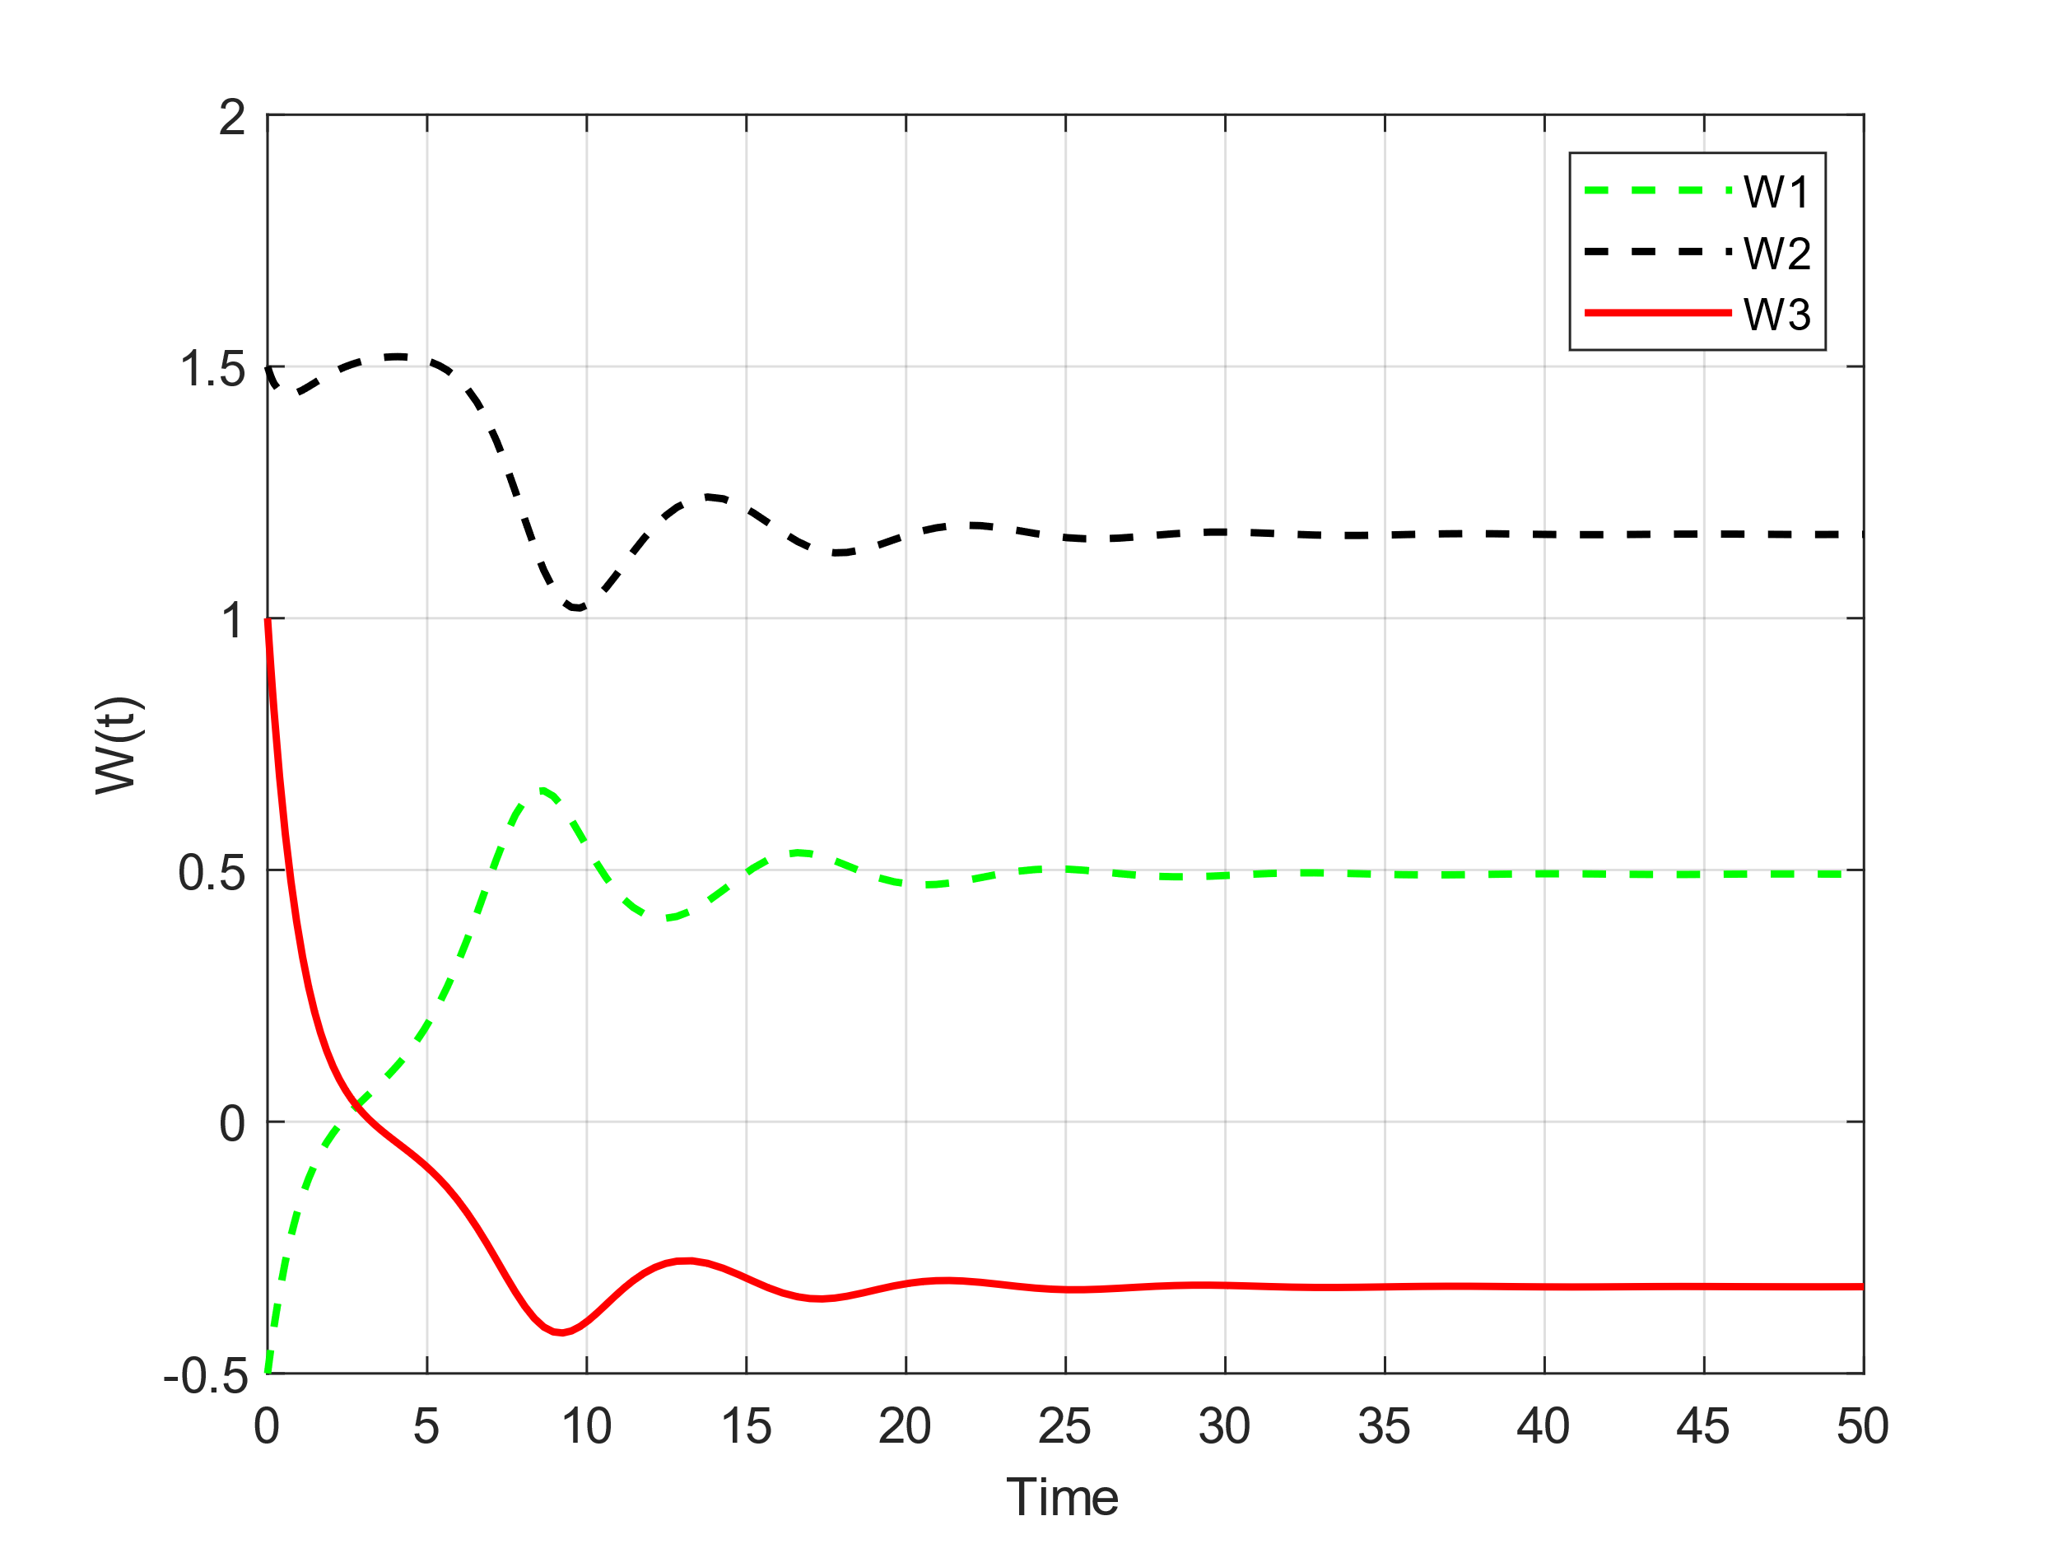
n₁ = 0.5, n₂ = 0.6, n₃ = 1.5
n₁ = 0.5, n₂ = 0.65, n₃ = 1.5

Slide 19
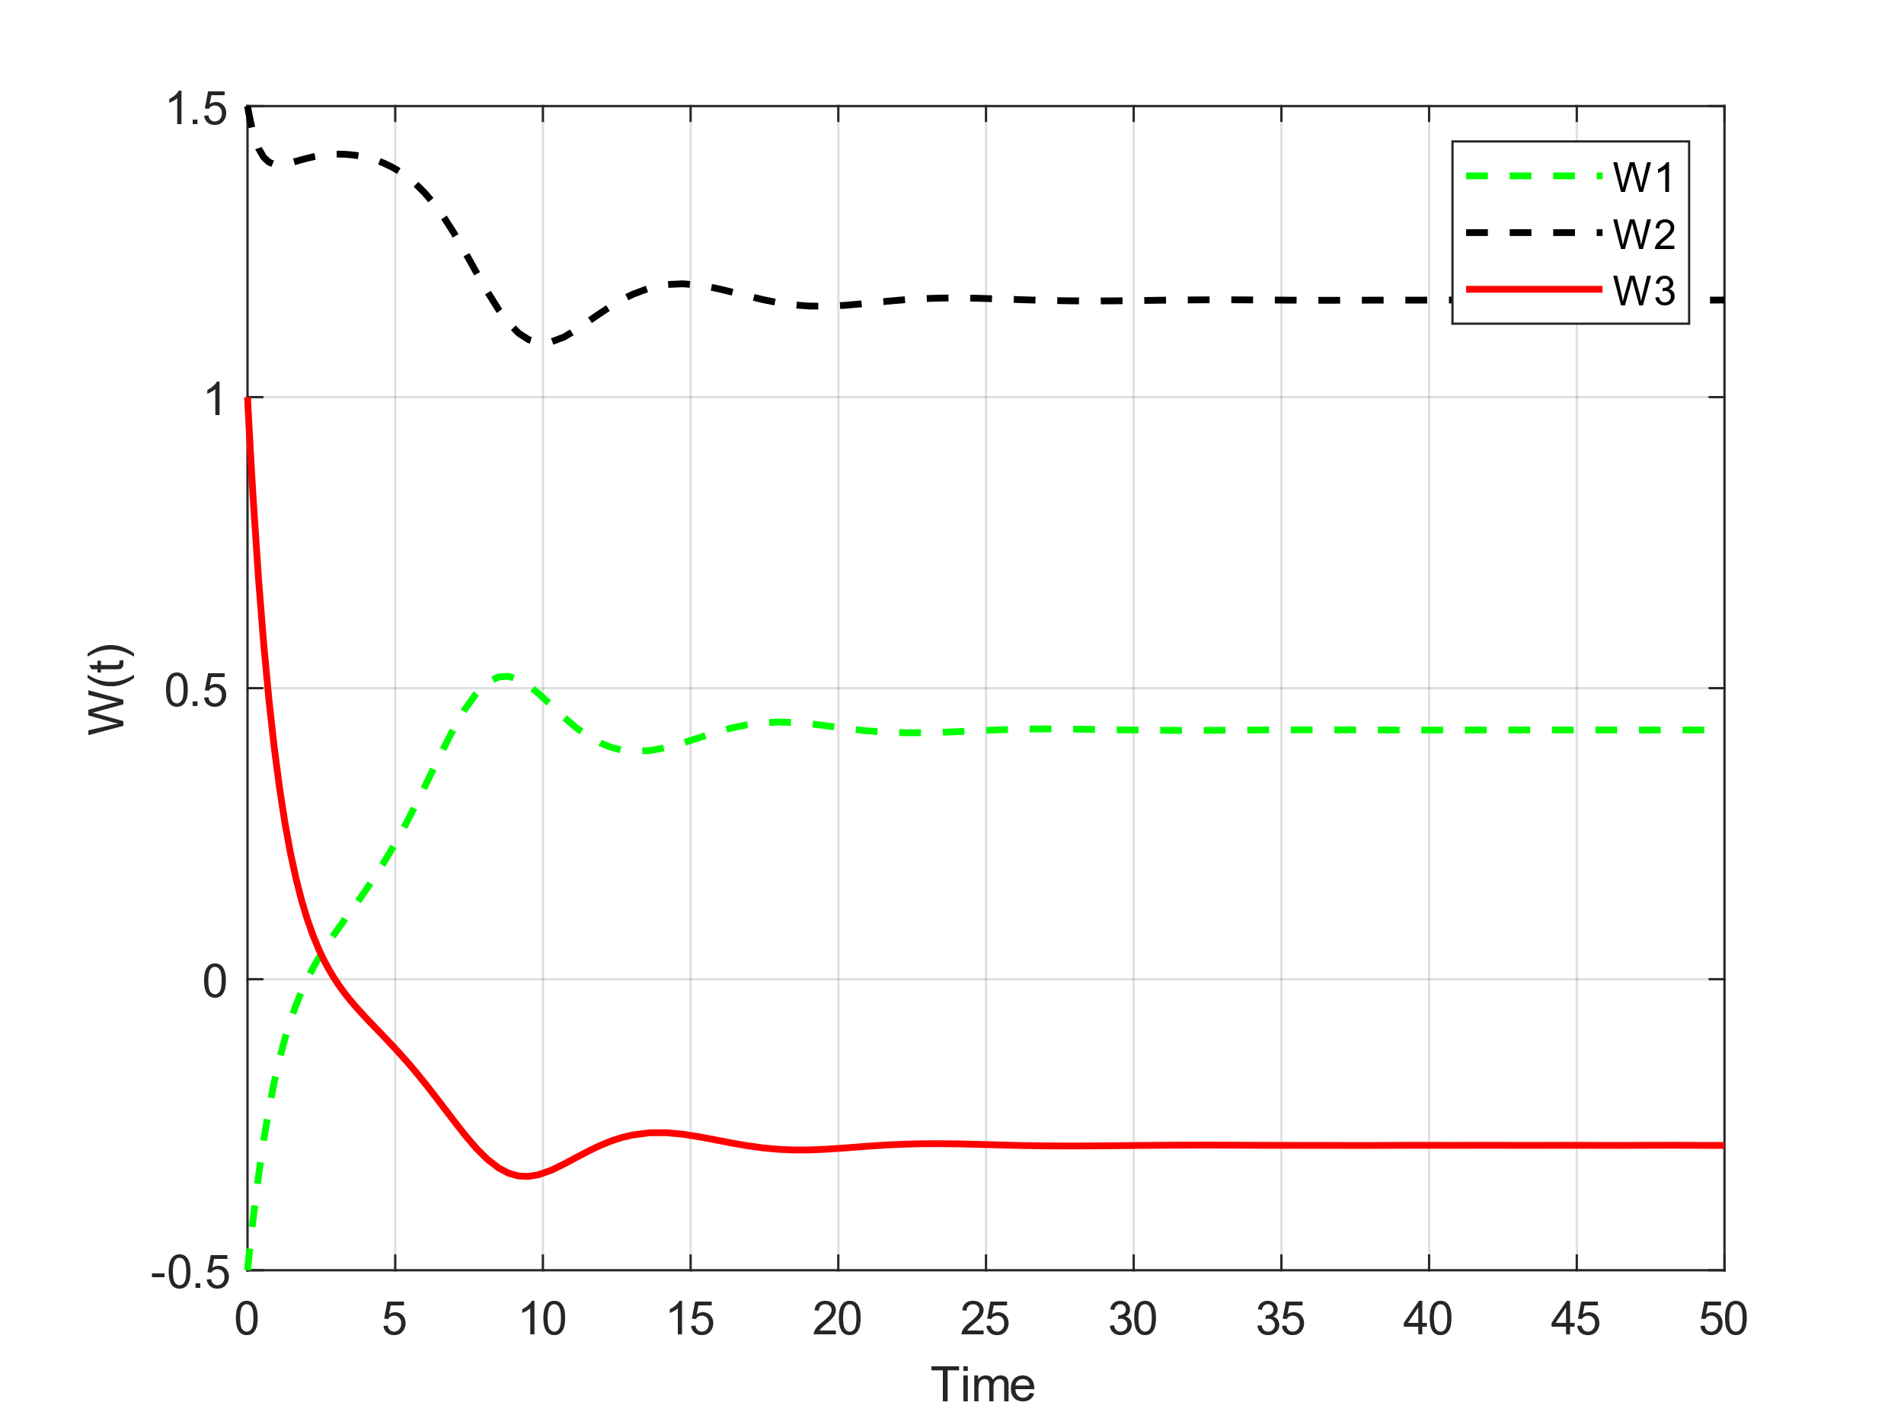
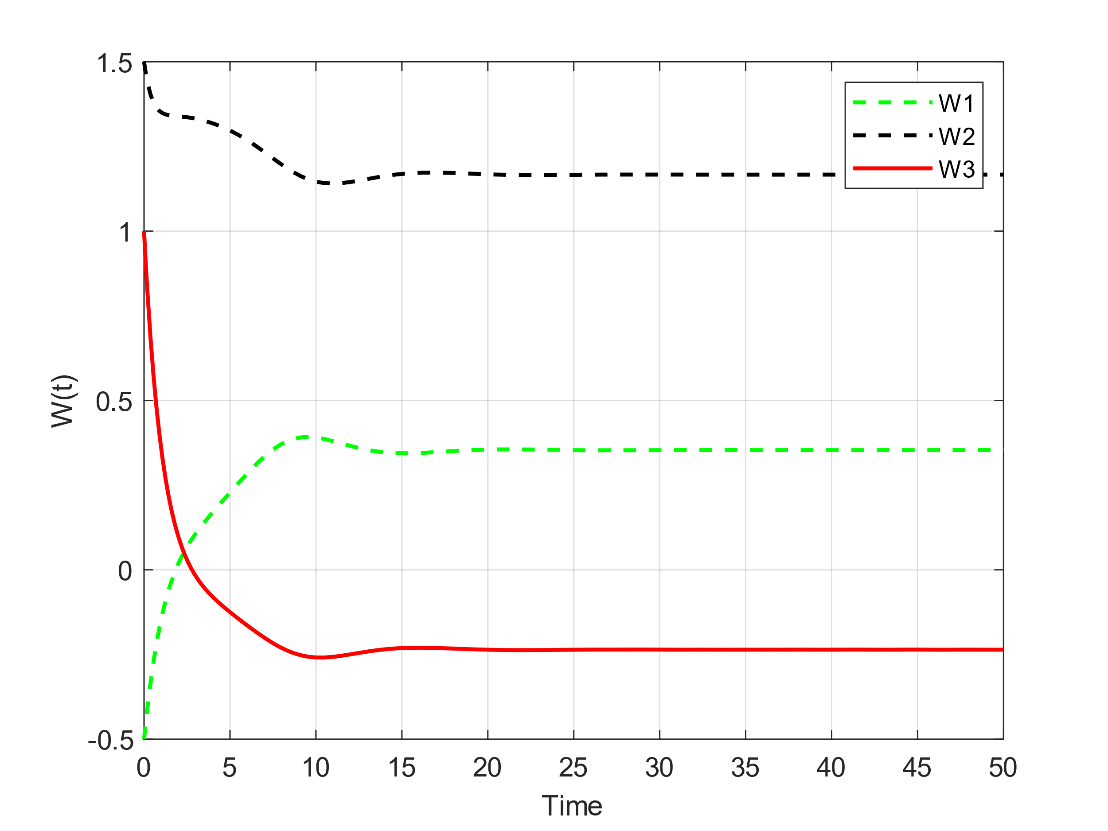
n₁ = 0.5, n₂ = 0.7, n₃ = 1.5
n₁ = 0.5, n₂ = 0.75, n₃ = 1.5

Slide 20
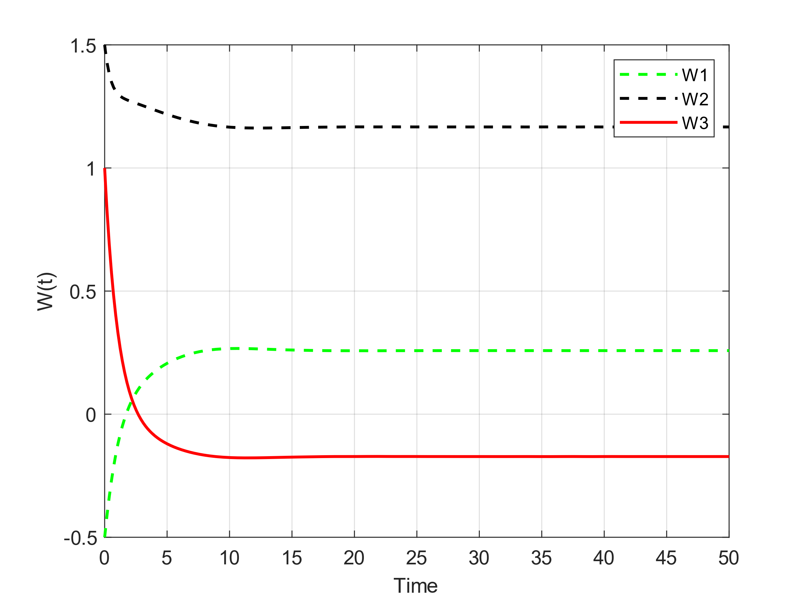
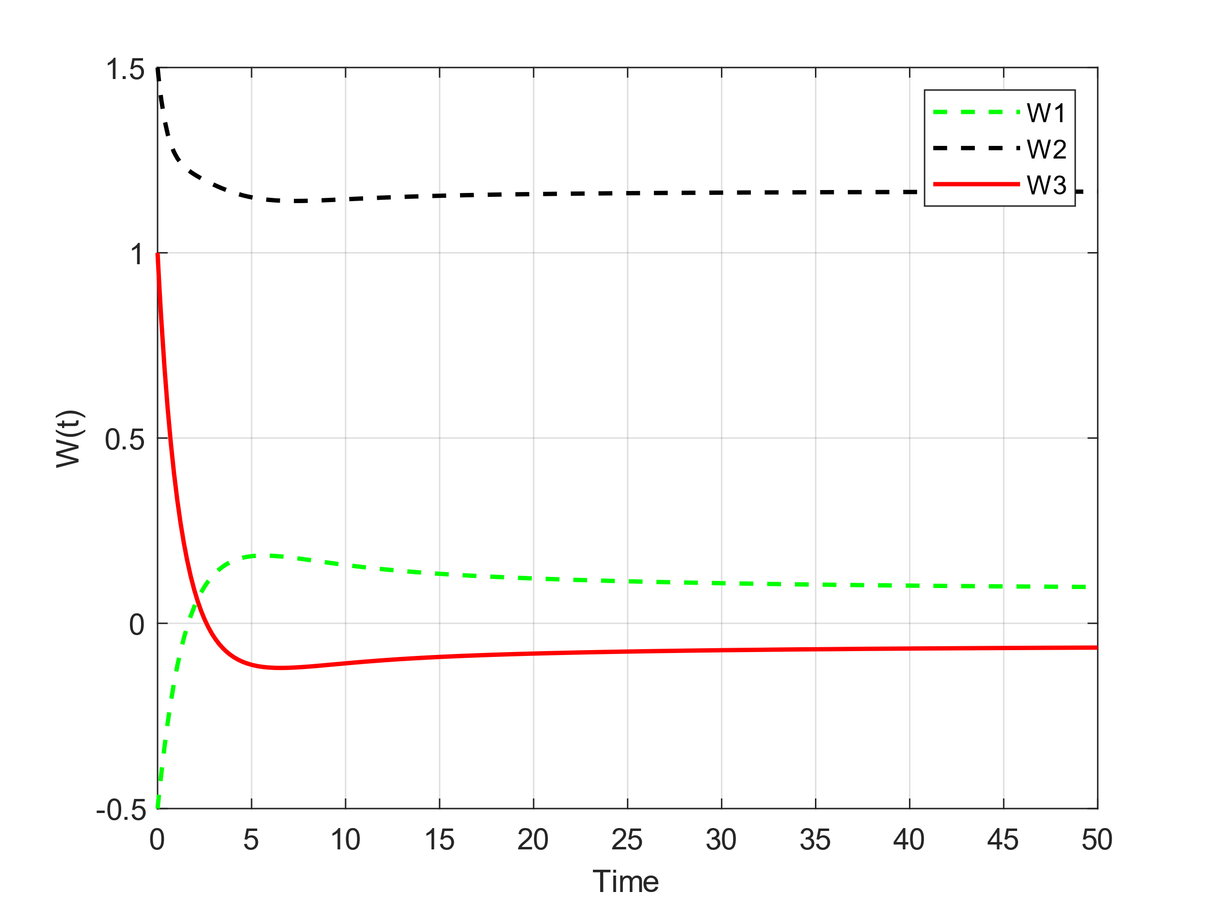
n₁ = 0.5, n₂ = 0.8, n₃ = 1.5
n₁ = 0.5, n₂ = 0.85, n₃ = 1.5

Slide 21
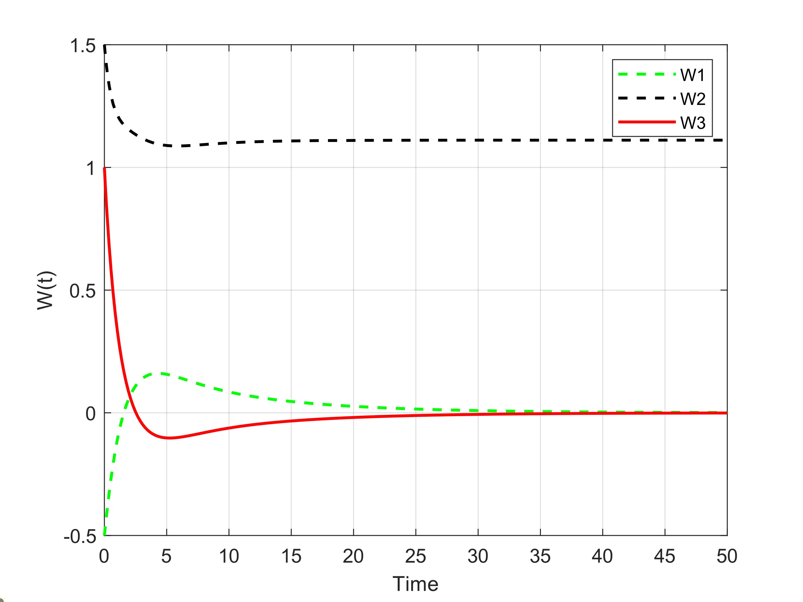
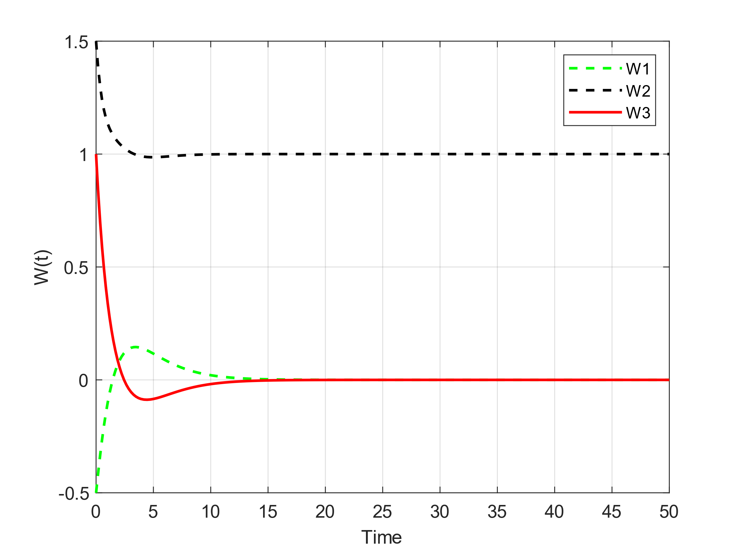
n₁ = 0.5, n₂ = 0.9, n₃ = 1.5
n₁ = 0.5, n₂ = 1, n₃ = 1.5

Slide 22
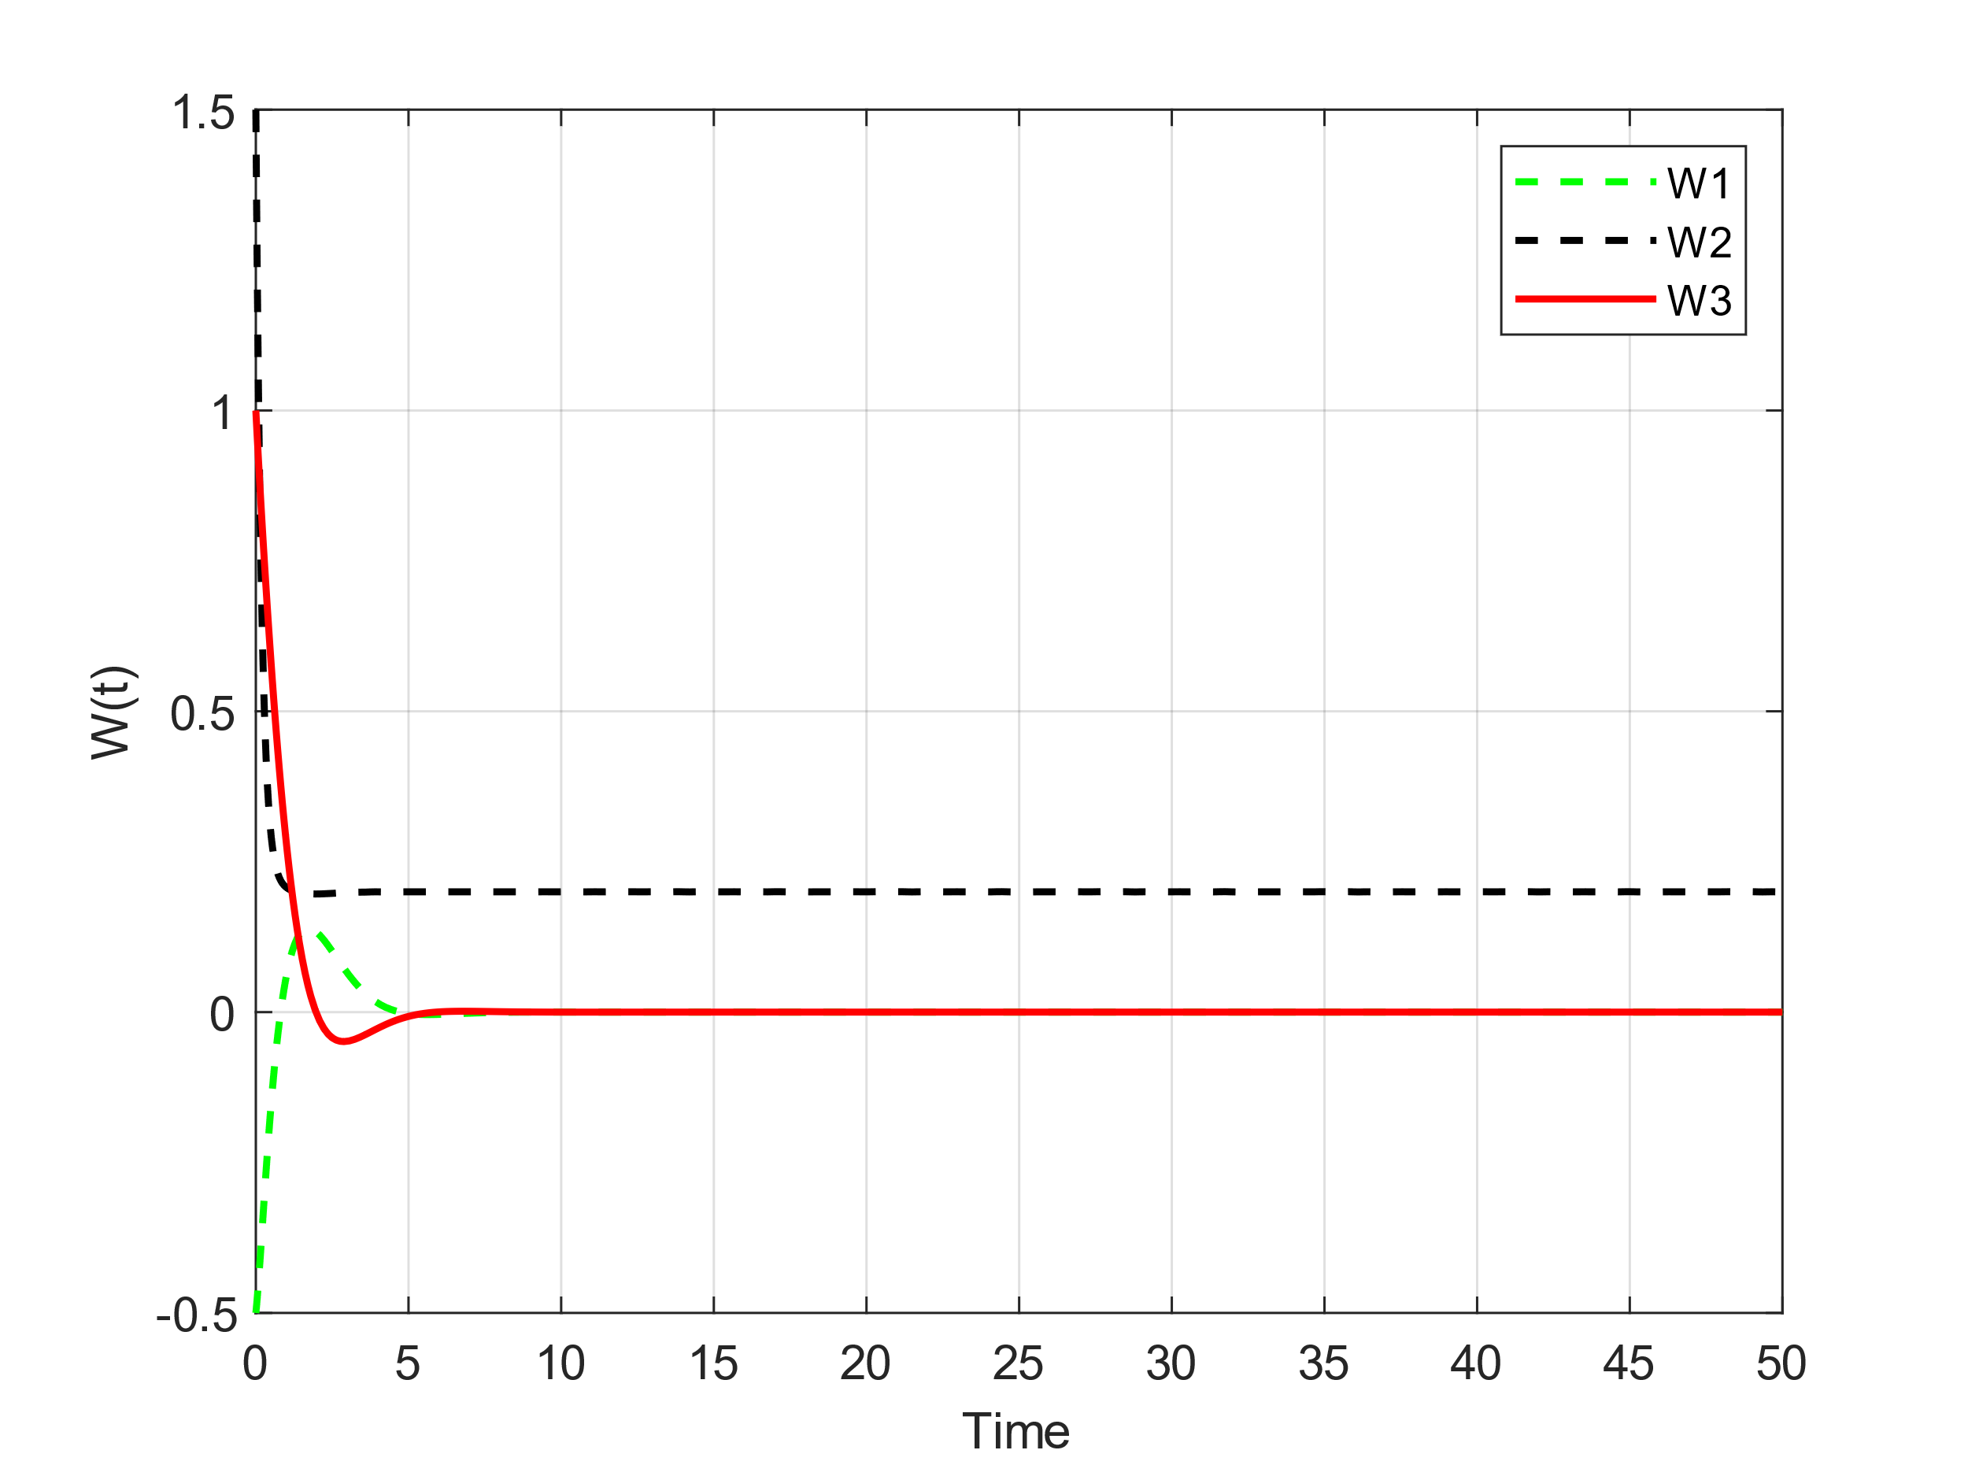
n₁ = 0.5, n₂ = 0.2, n₃ = 1.5
n₁ = 0.5, n₂ = 0.45, n₃ = 1.5
n₁ = 0.5, n₂ = 5, n₃ = 1.5
As it is clear from the graphs, for small n₂, the system has a limit cycle and when its value is greater than a certain value (0.372 here according to the rest of the parameters), the system is damped and its phase diagram is It spirals. If we make n2 bigger, the damping speed will increase, and if we set it higher than 0.858, due to the negation of the term under the radical, 2 fixed points will be removed and we will have only one absorbing point. Of course, we should also consider that our fixed points change with the change of n2 value. If n₂ goes to infinity, the system will have an absorbing point in [0, 0, 0].

Slide 23
Impact of the parameter n₃
Initial conditions: w₁(0) = -0.5, W₂(0) = 1.5, W₃(0) = 1;
n₁ = 0.5, n₂ = 0.2, n₃ = 1.5
Fixed points =
[0, 5, 0] ,
[sqrt(0.9 – 0.2/n₃), 0.5 + 1/n₃ , - 1/n₃ sqrt(0.9 – 0.2/n₃)],
[-sqrt(0.9 – 0.2/n₃), 0.5 + 1/n₃ , 1/n₃ sqrt(0.9 – 0.2/n₃)]
All parameters are fixed except n₃. We vary n₂ at each step to observe its effect on the behavior of the system.

Slide 24
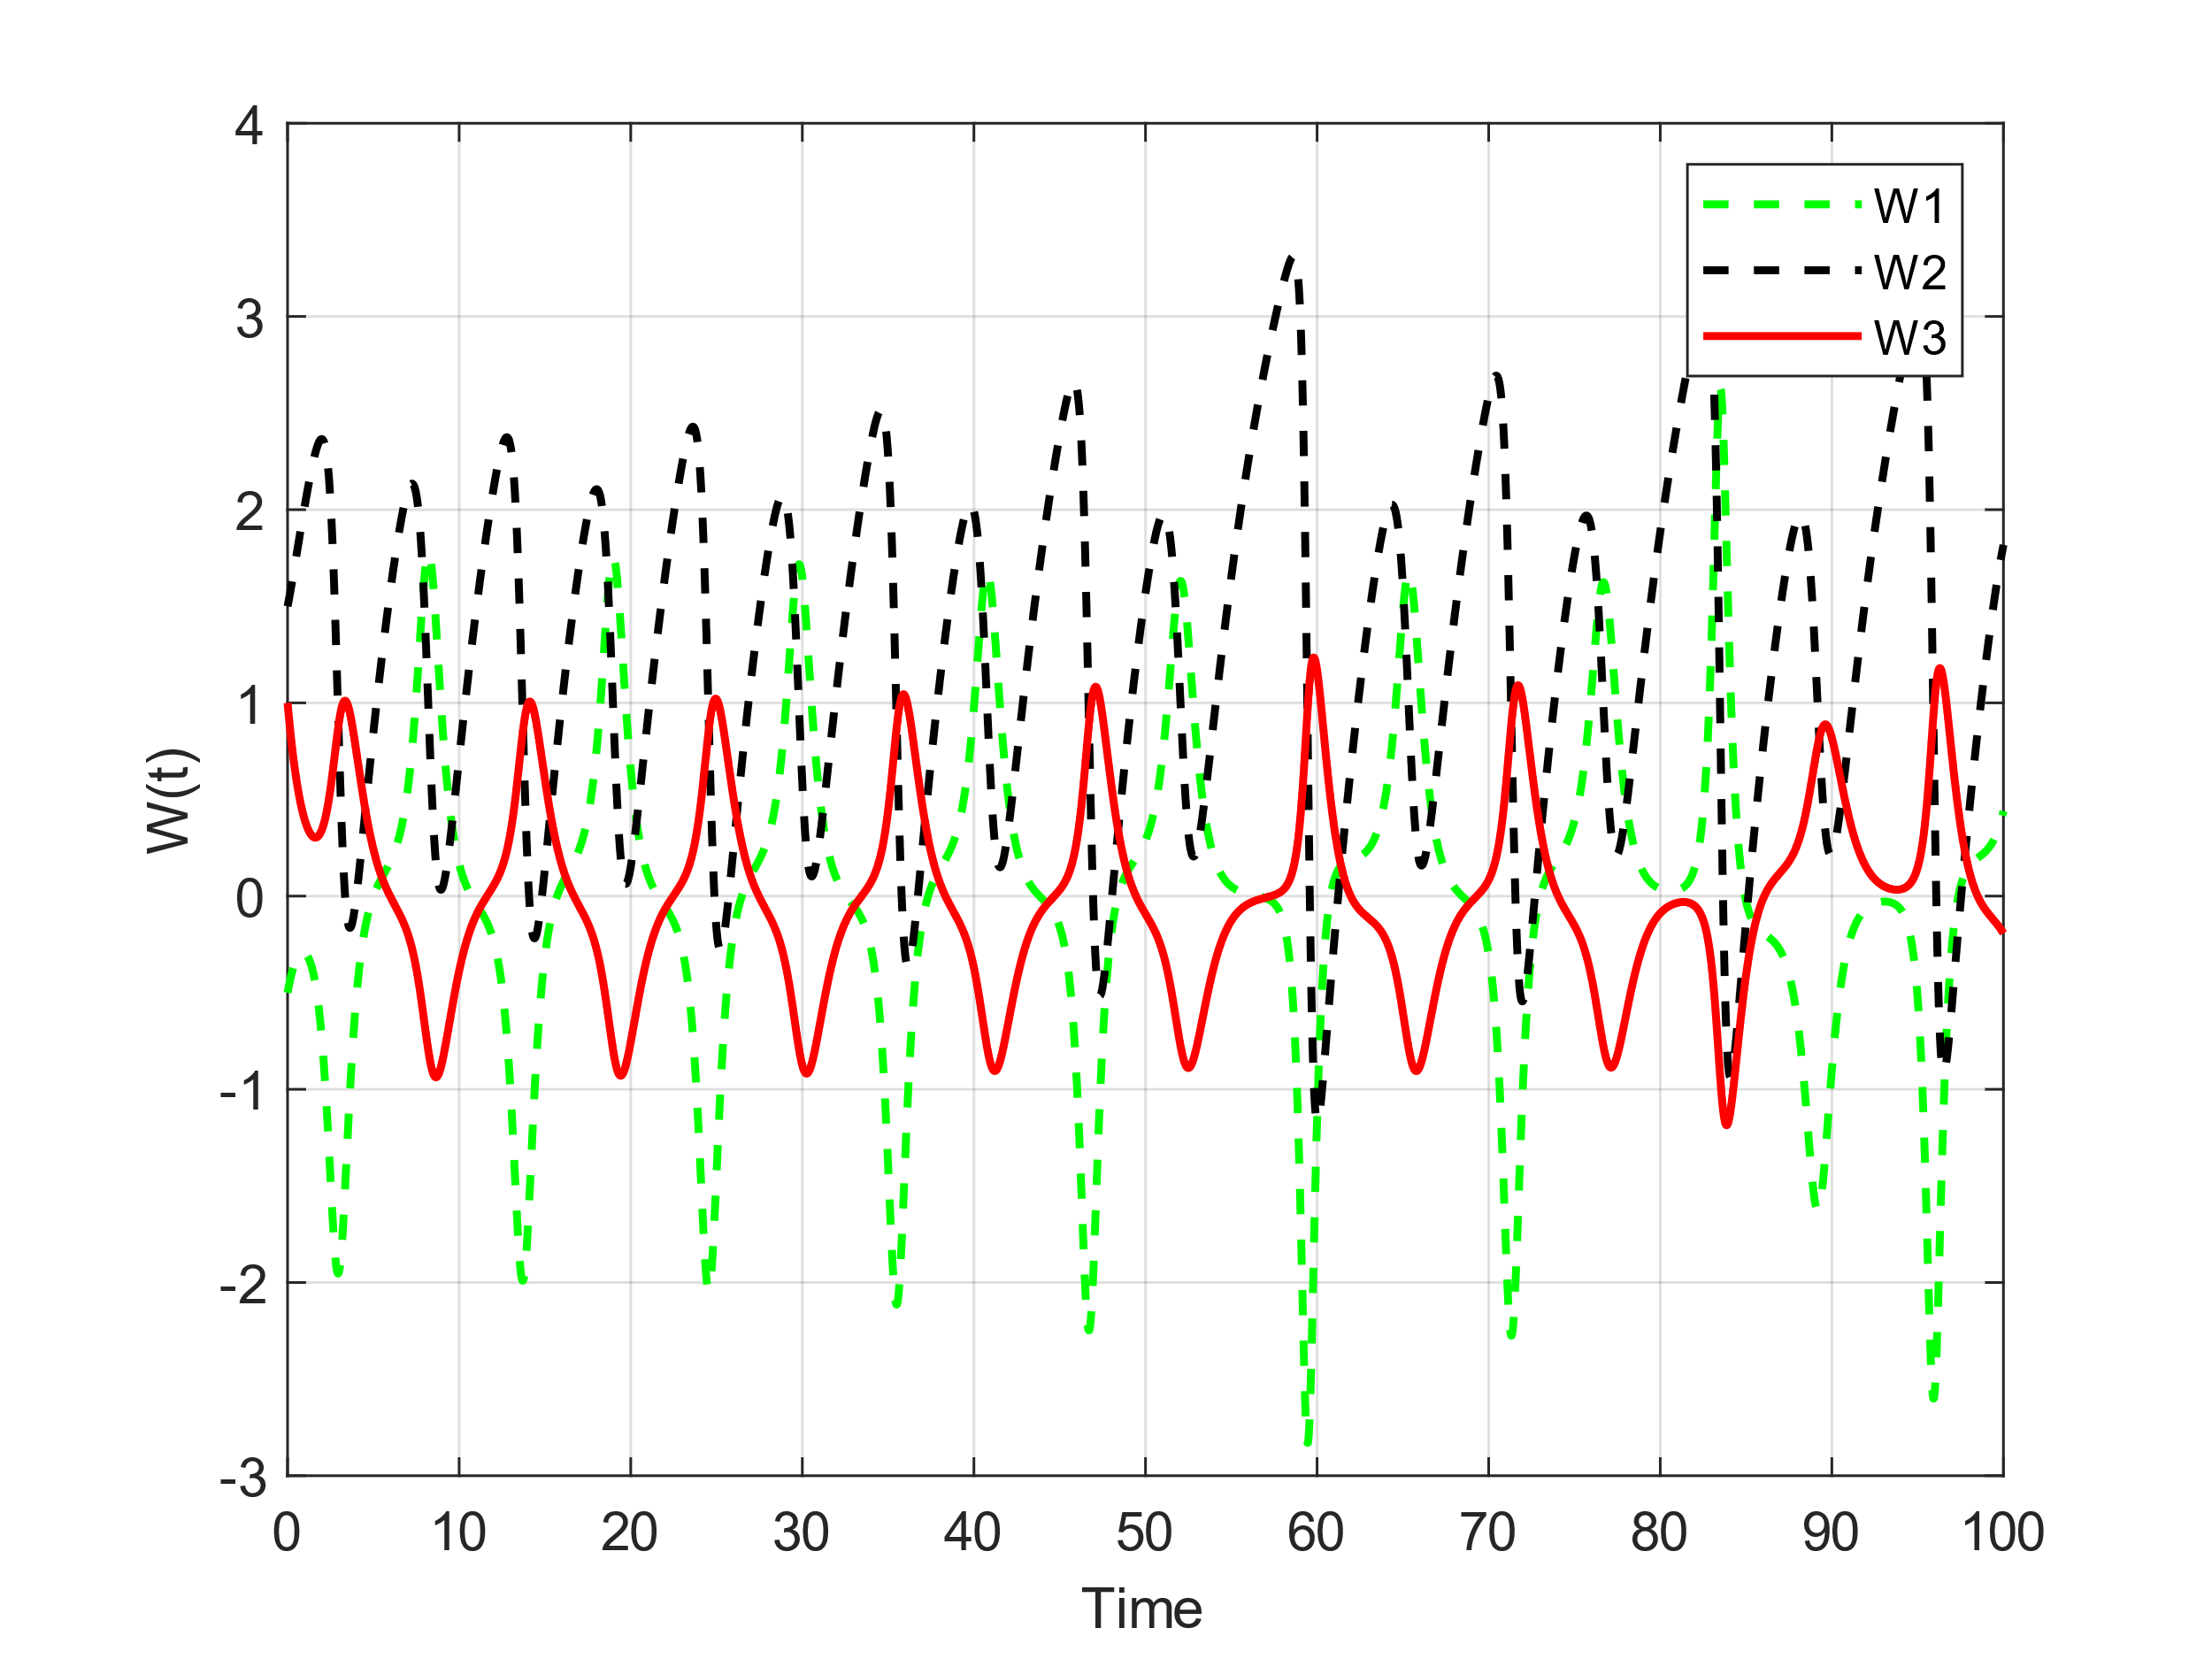
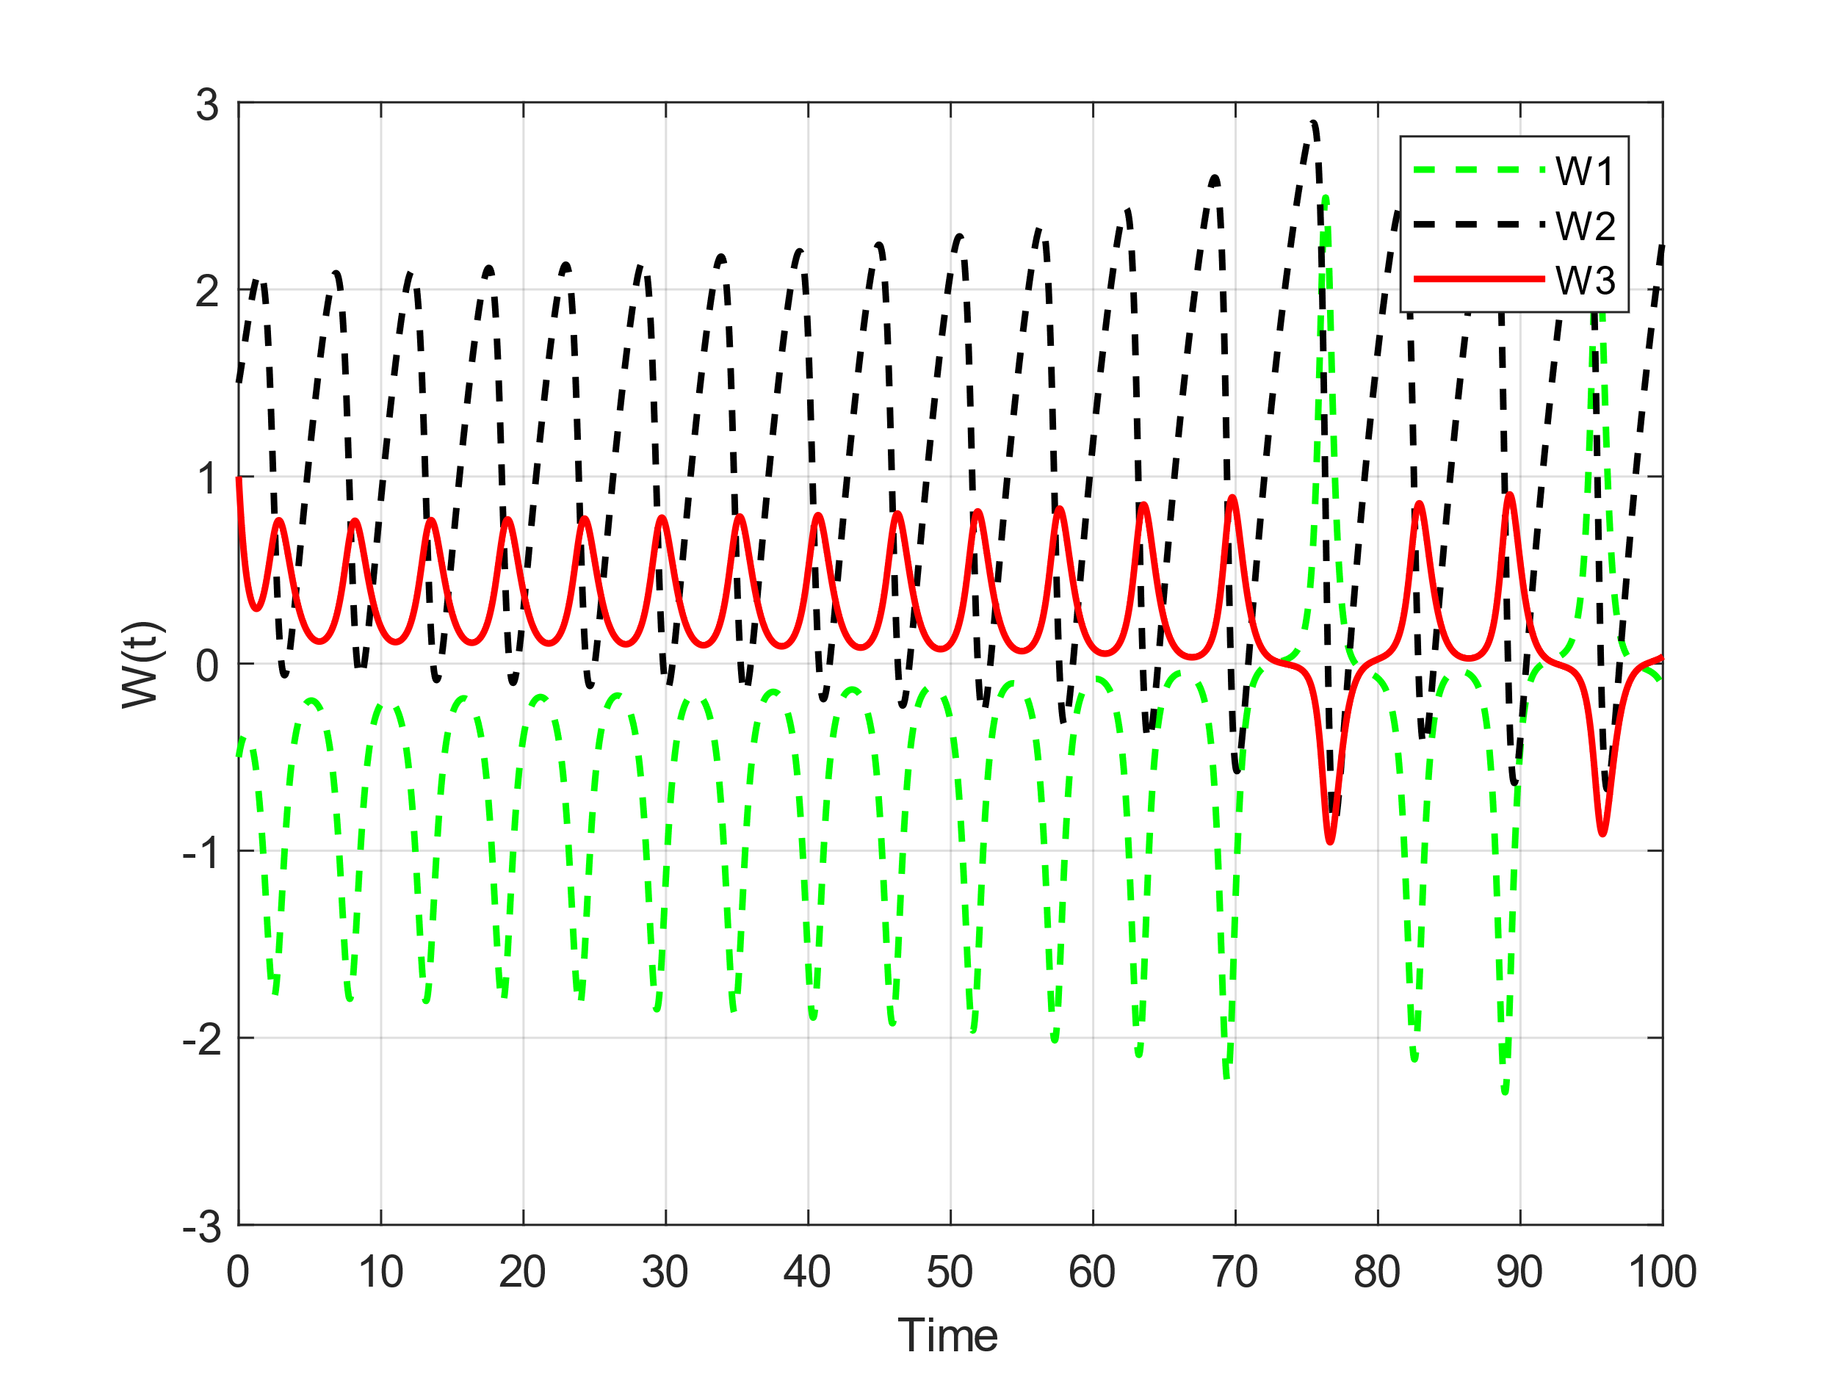
n₁ = 0.5, n₂ = 0.2, n₃ = 1.5
n₁ = 0.5, n₂ = 0.2, n₃ = 2

Slide 25
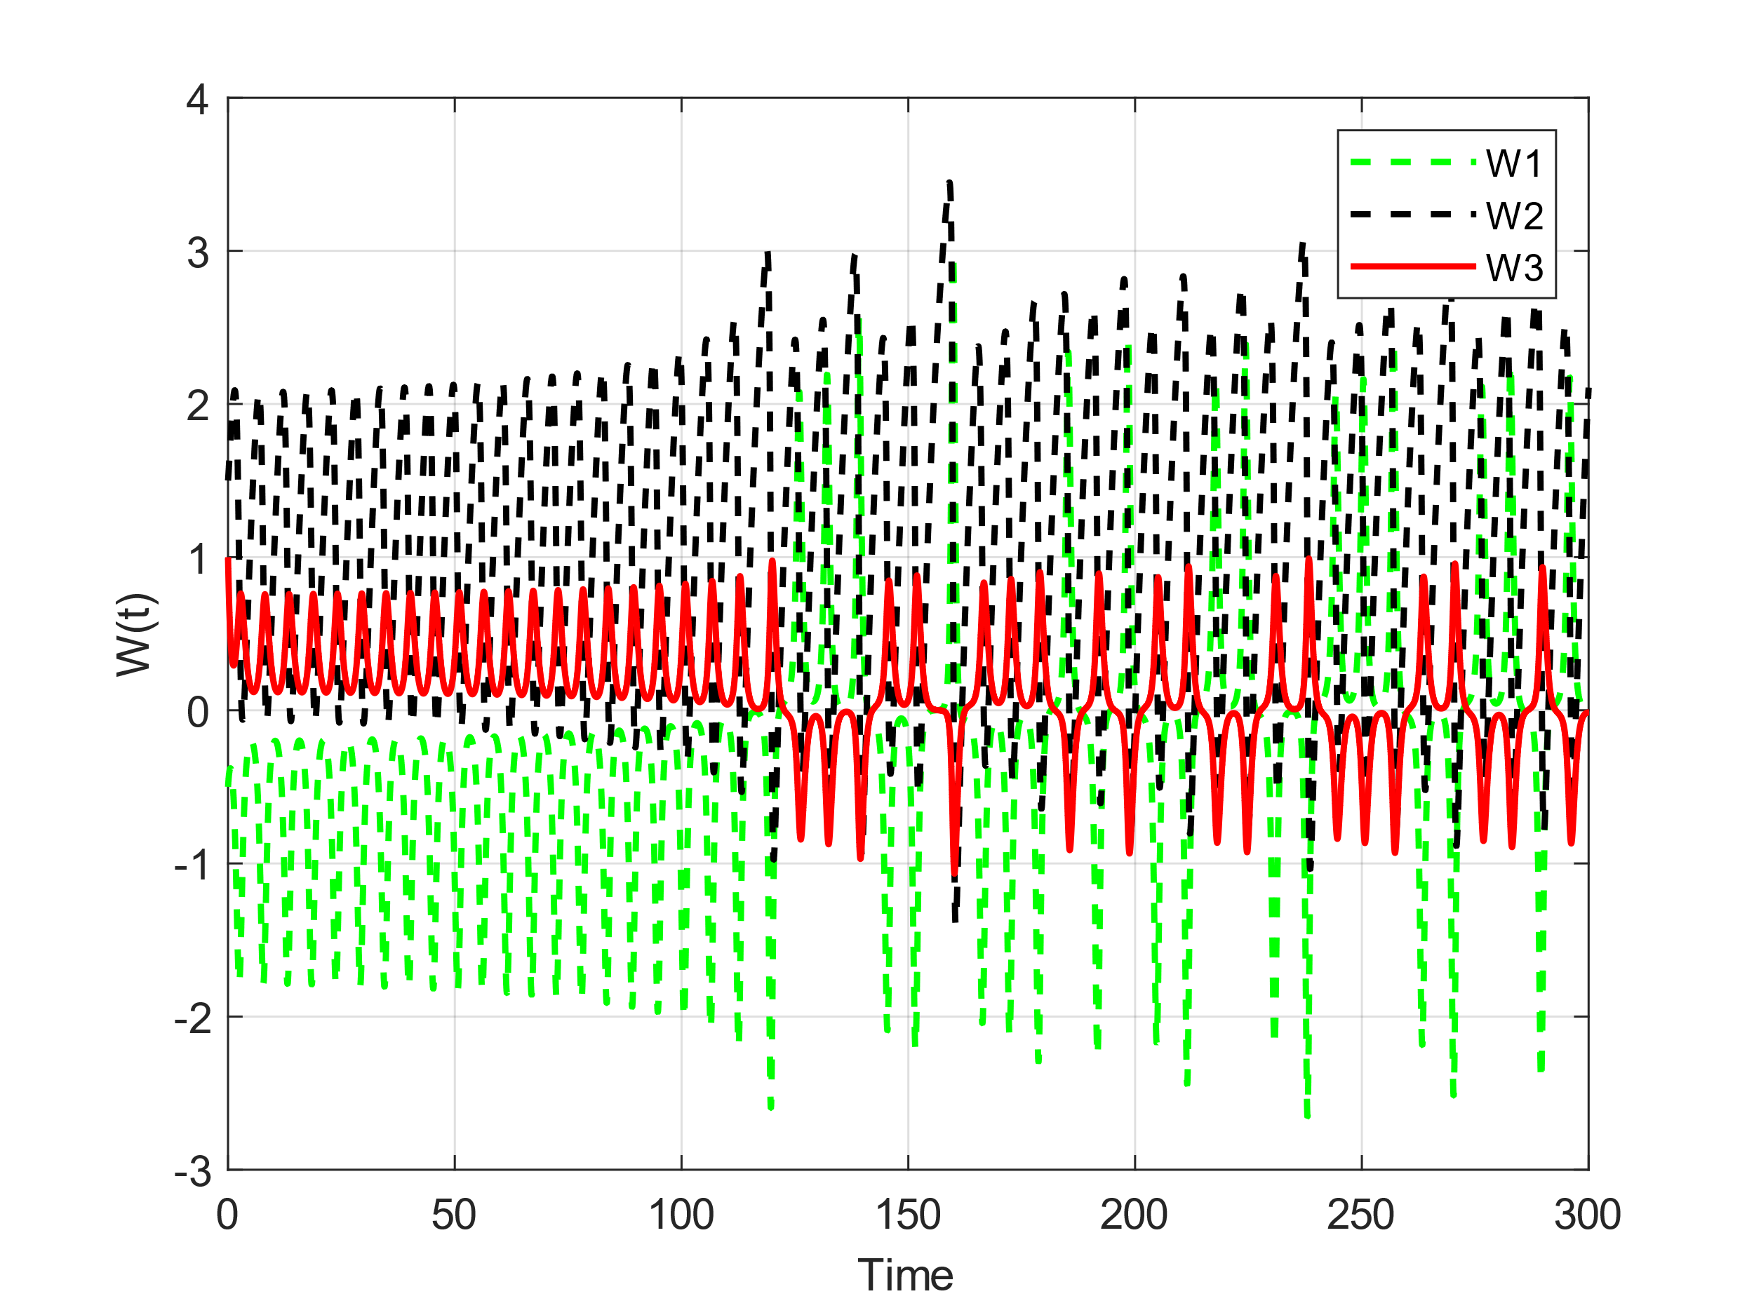
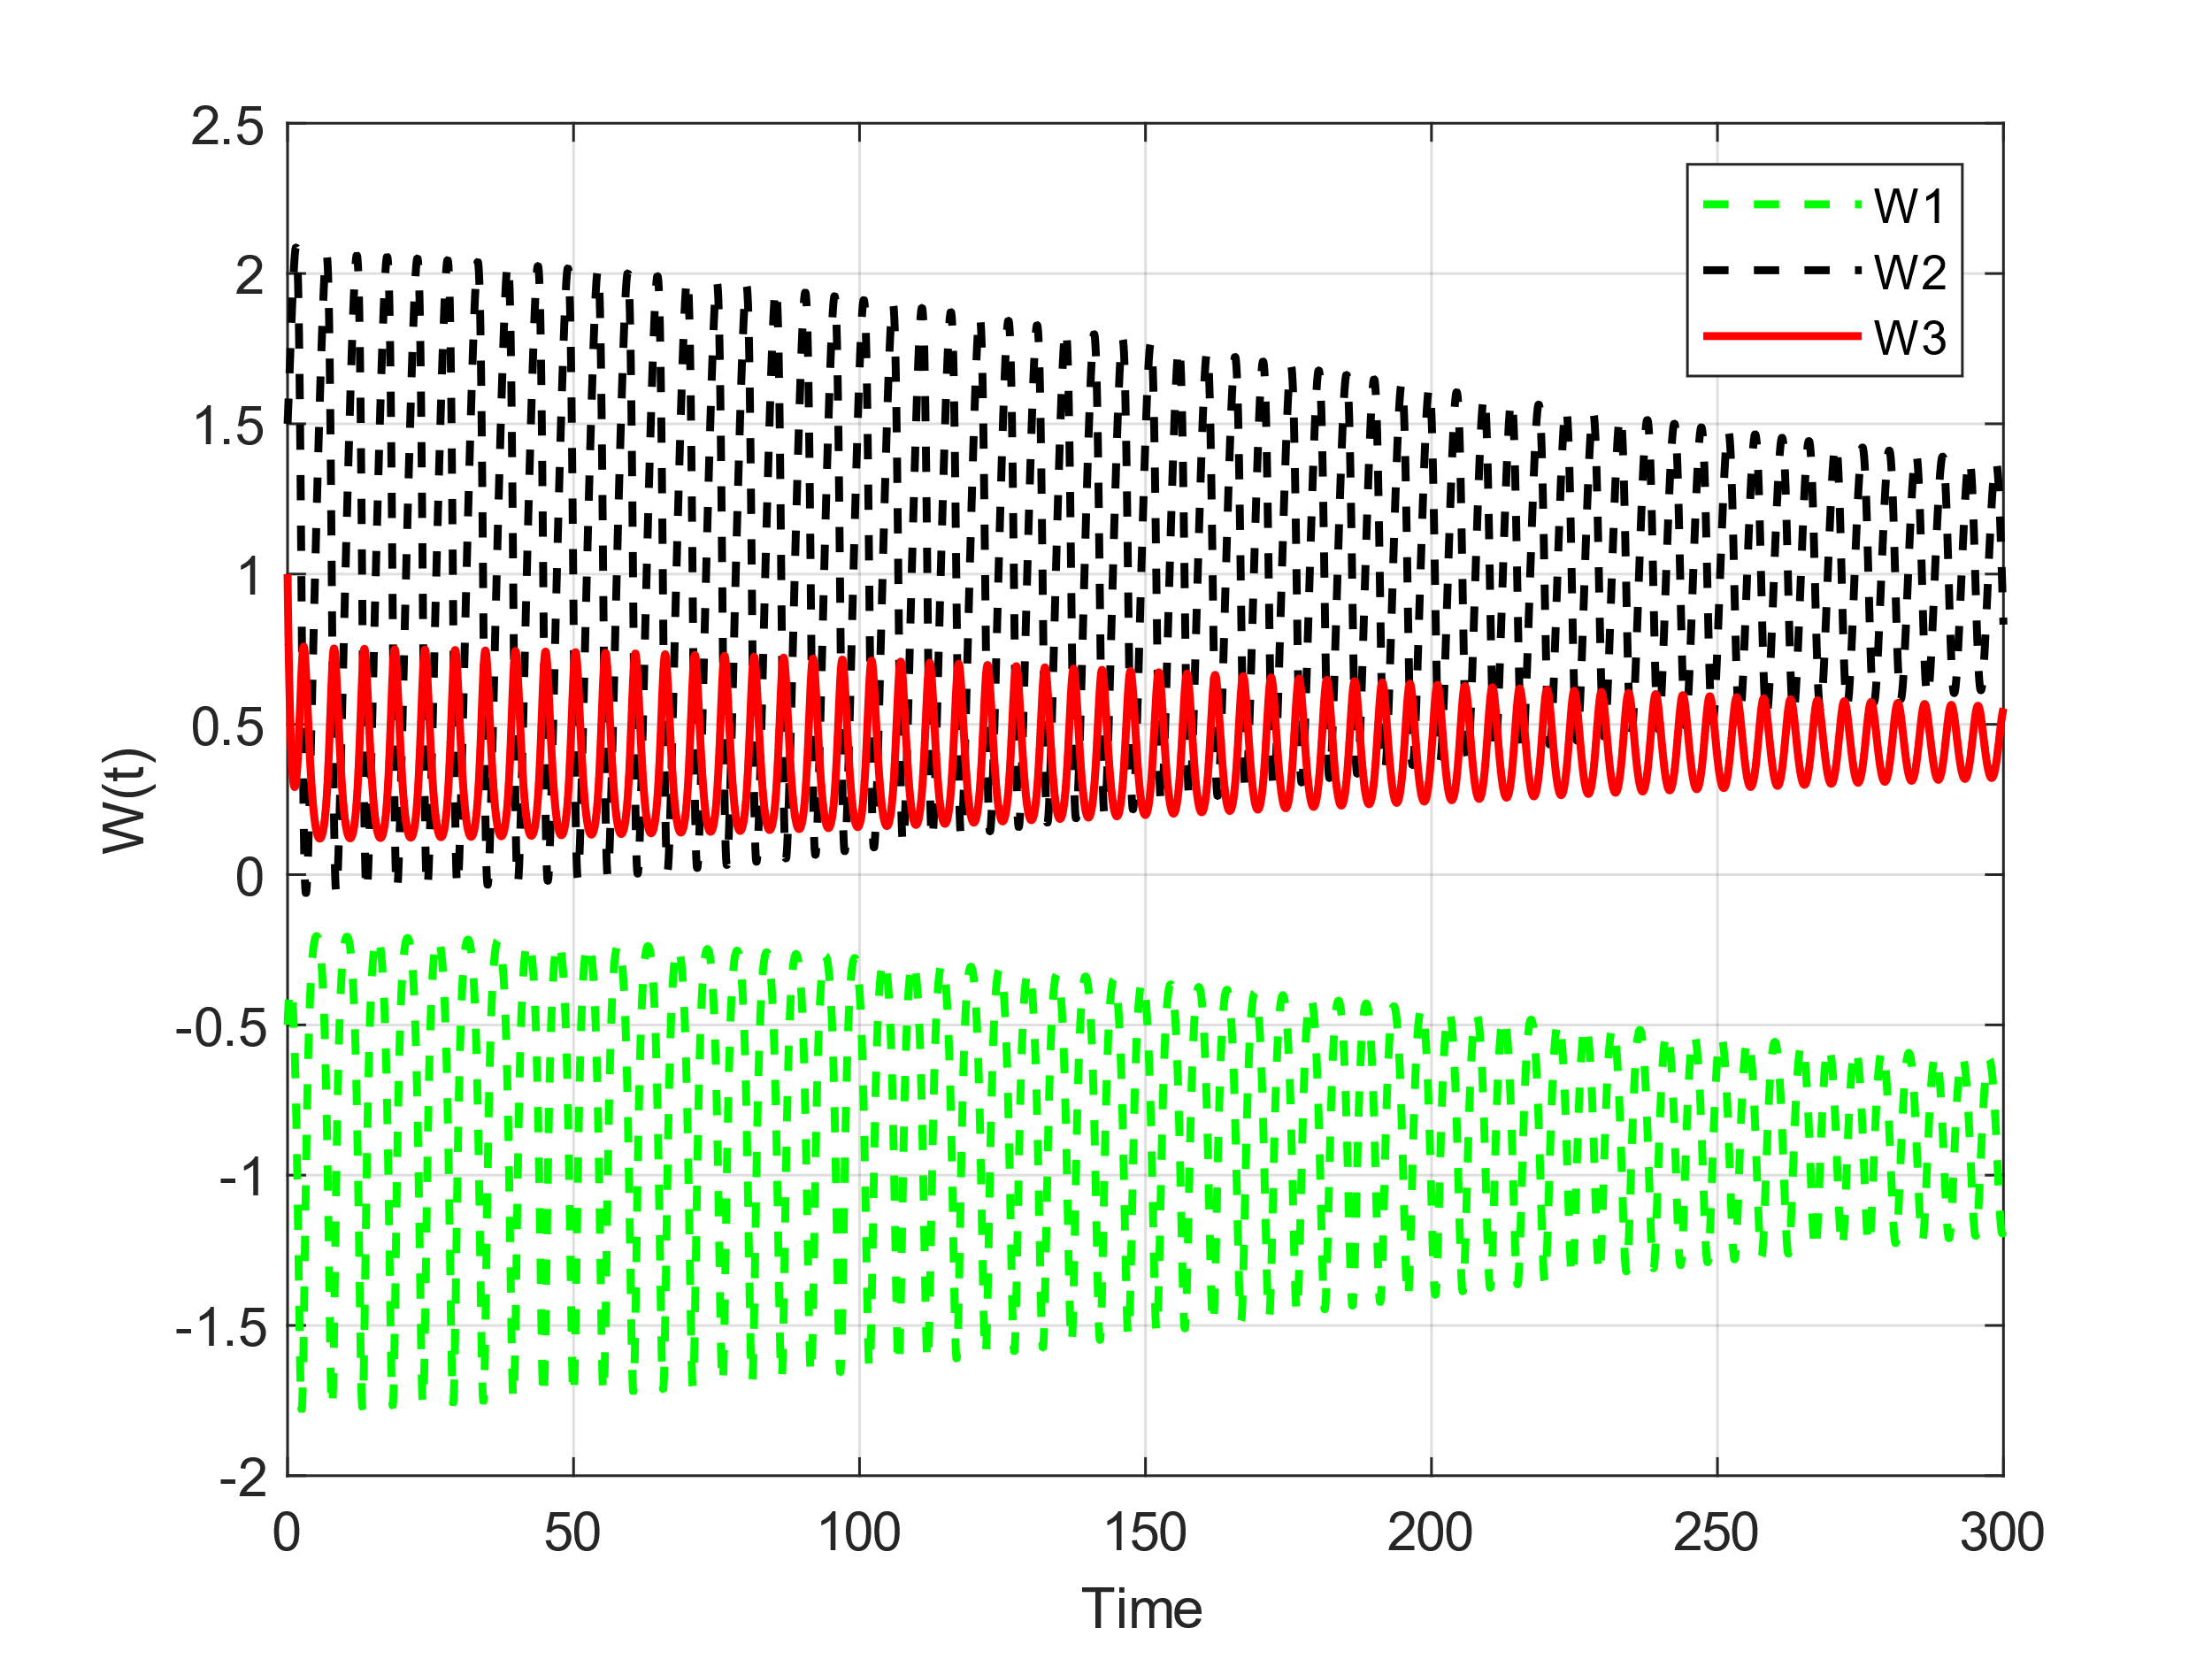
n₁ = 0.5, n₂ = 0.2, n₃ = 2.01
n₁ = 0.5, n₂ = 0.2, n₃ = 2.02

Slide 26
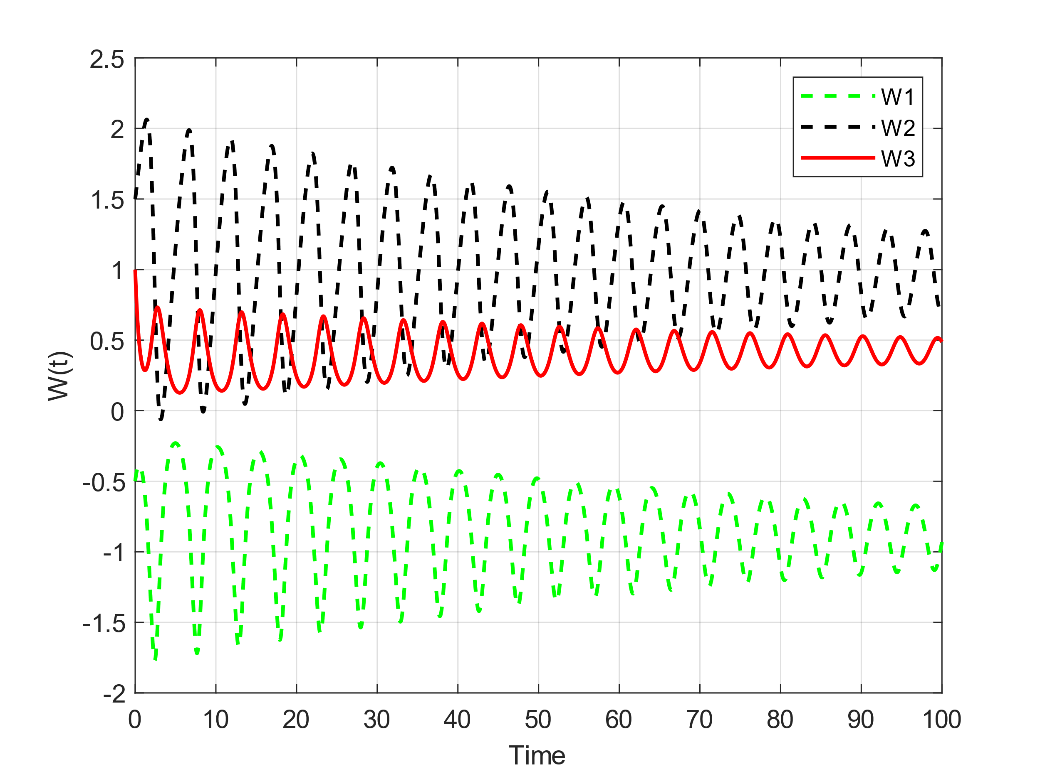
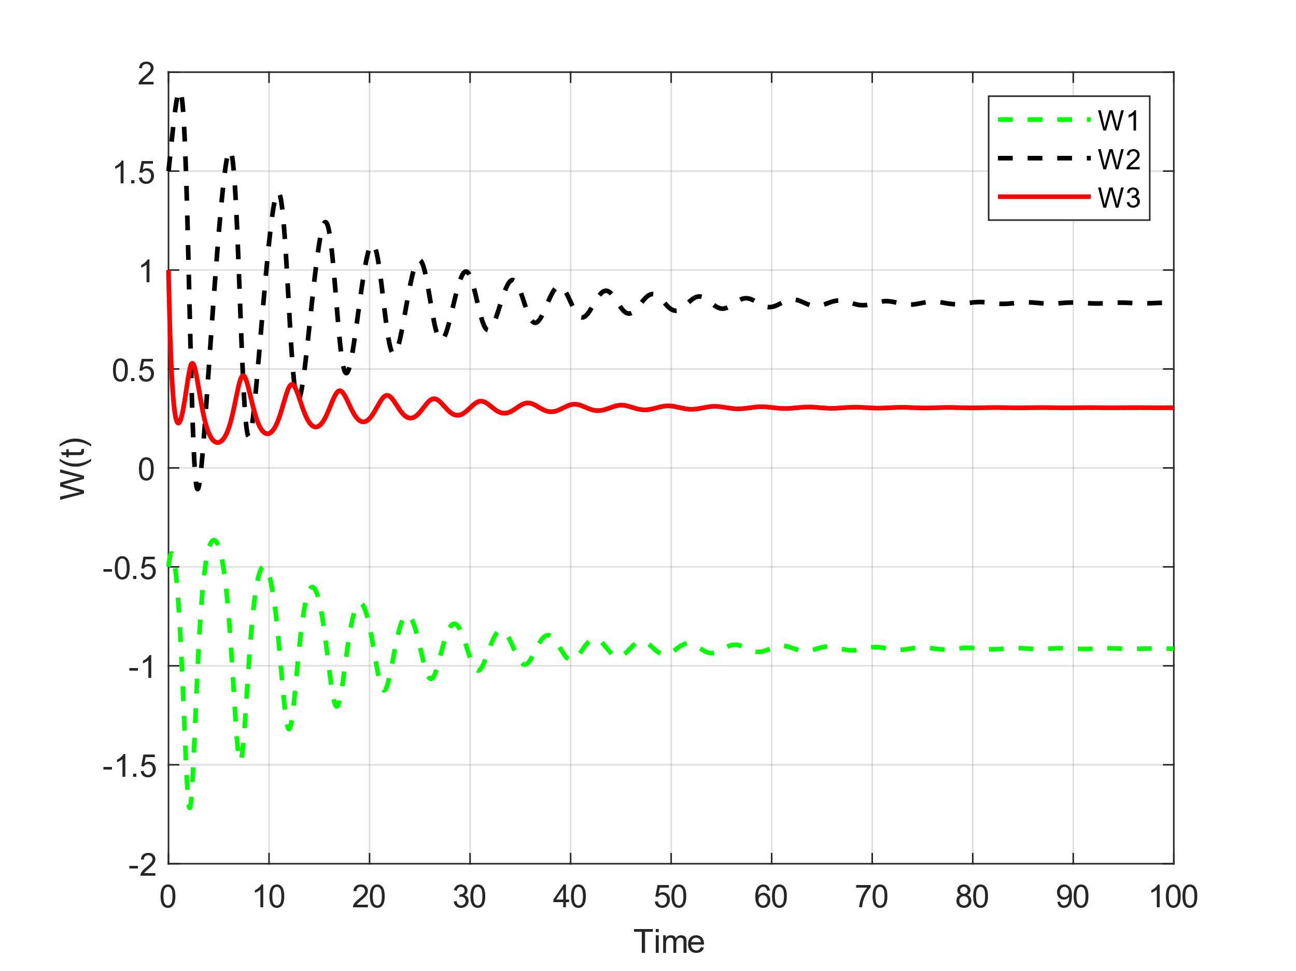
n₁ = 0.5, n₂ = 0.2, n₃ = 2.1
n₁ = 0.5, n₂ = 0.2, n₃ = 3

Slide 27
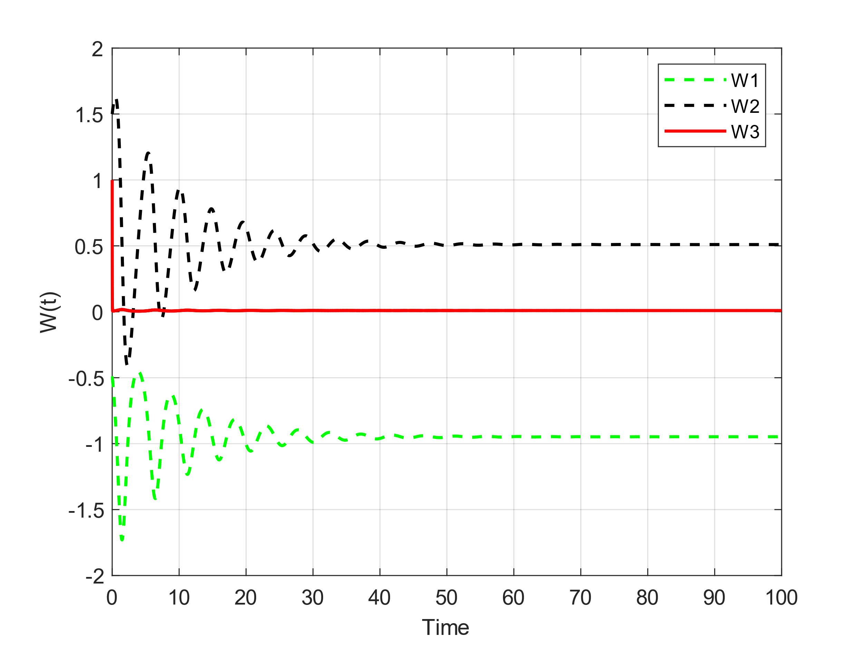

n₁ = 0.5, n₂ = 0.2, n₃ = 100
n₁ = 0.5, n₂ = 0.2, n₃ = 1000

Slide 28
n₁ = 0.5, n₂ = 0.2, n₃ = 1.5
n₁ = 0.5, n₂ = 0.2, n₃ = 2.1
n₁ = 0.5, n₂ = 0.2, n₃ = 1000
As it is clear from the graphs, for small n₃, the system has a limit cycle and when its value is greater than a certain value (here according to the other parameters 2.01), the system is damped and its phase diagram is It spirals. If we increase n₃, the damping speed increases. Finally, if we take n₃ to infinity, the time response diagram of the system remains constant and looks almost like the figure on the right. Unlike the two parameters n₂ and n₁, increasing the n₃ parameter does not remove those 2 fixed points, and our system has 3 fixed points [0, 5, 0], [0.95, 0.5, 0] when n₃ goes to infinity. , [-0.95, 0.5, 0] where the points [-0.95, 0.5, 0], [0.95, 0.5, 0] are absorbers.

Slide 29
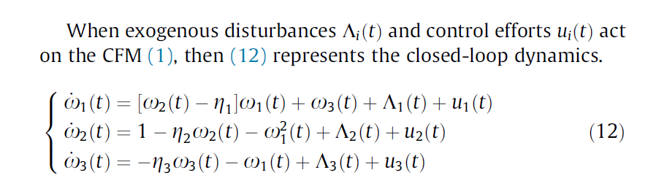
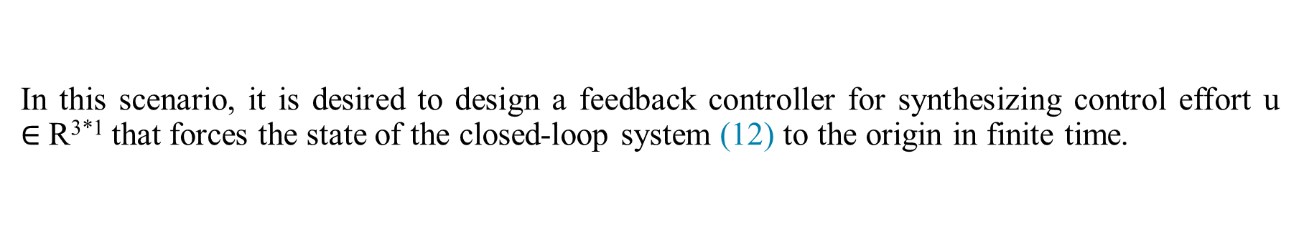
In this scenario, it is desired to design a feedback controller for synthesizing control effort u $∈$R^{3*1} that forces the state of the closed-loop system (12) to the origin in finite time.
Proposed System

Slide 30
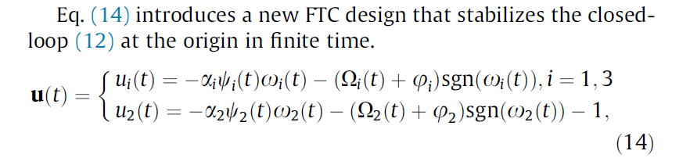
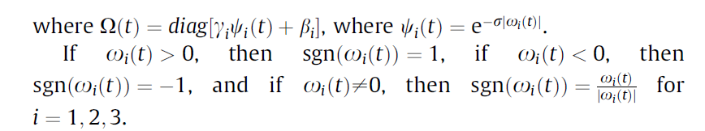
Proposed finite-time controller

Slide 31
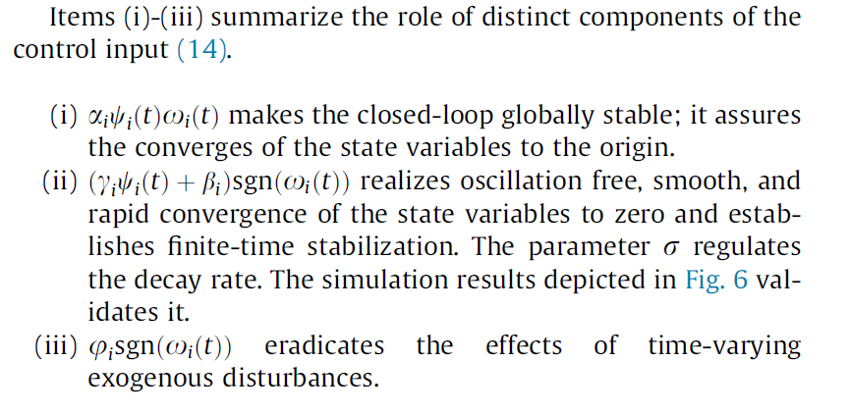

Slide 32
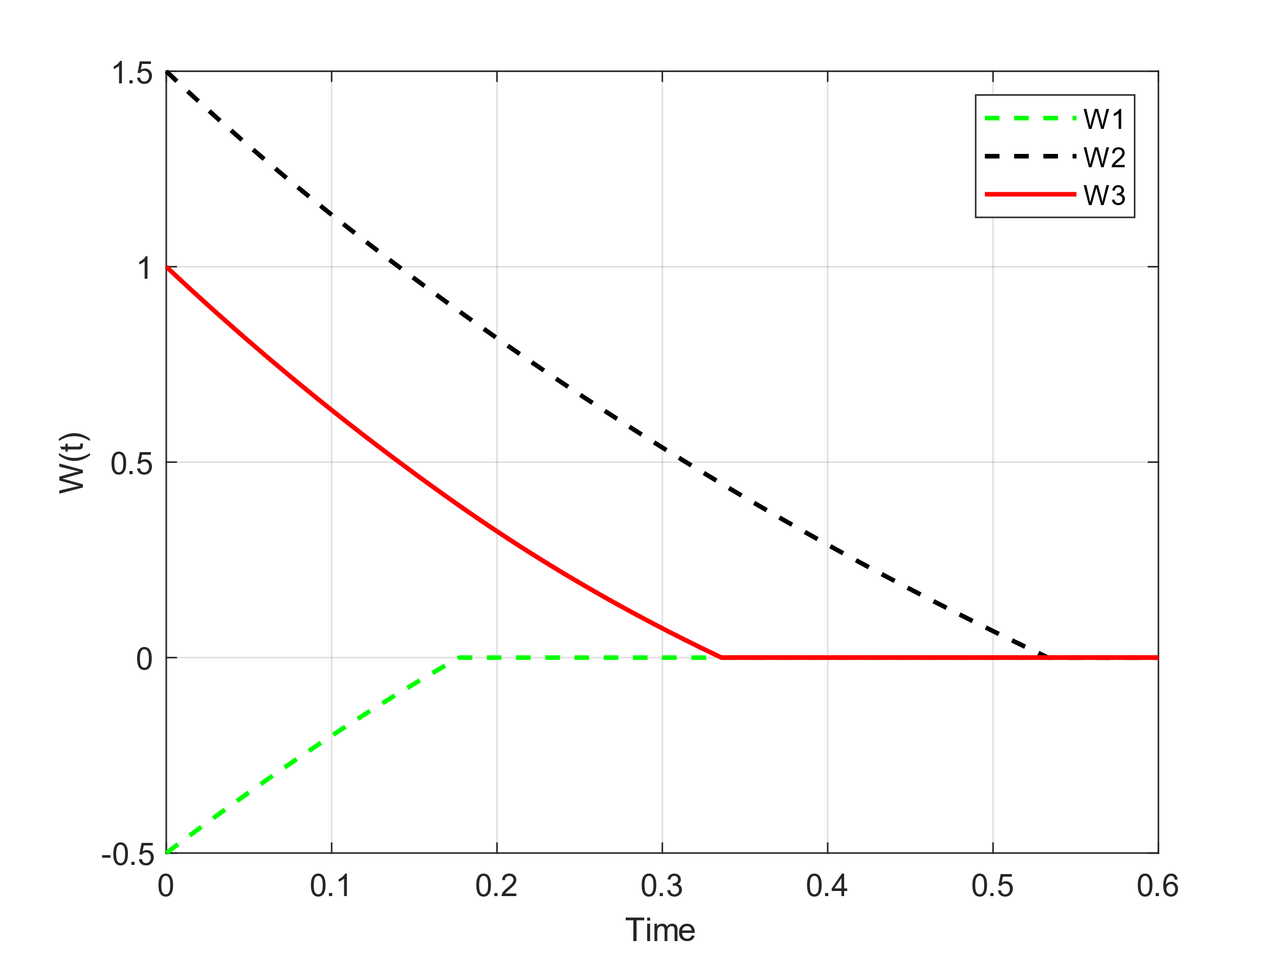
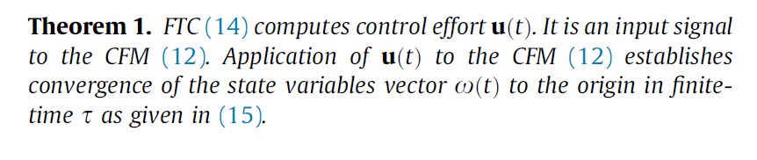
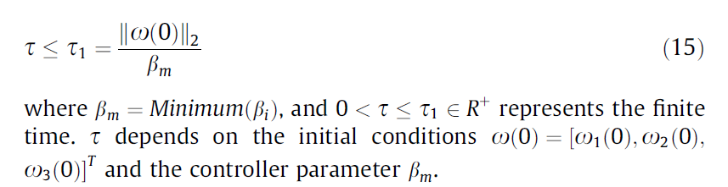
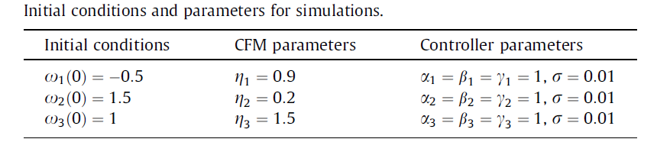

Slide 33
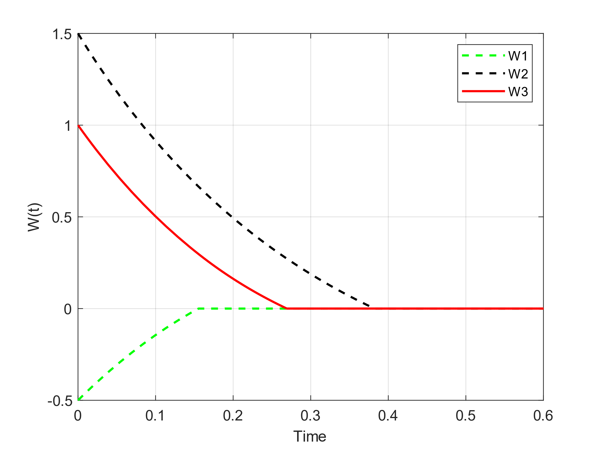
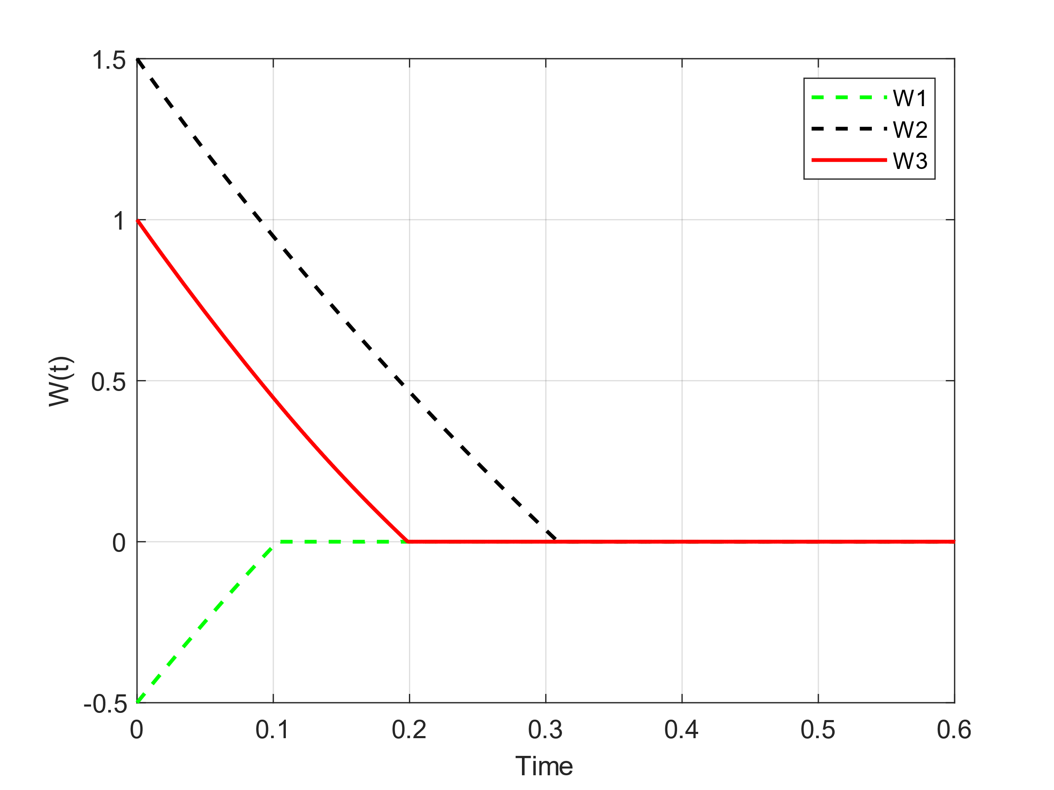
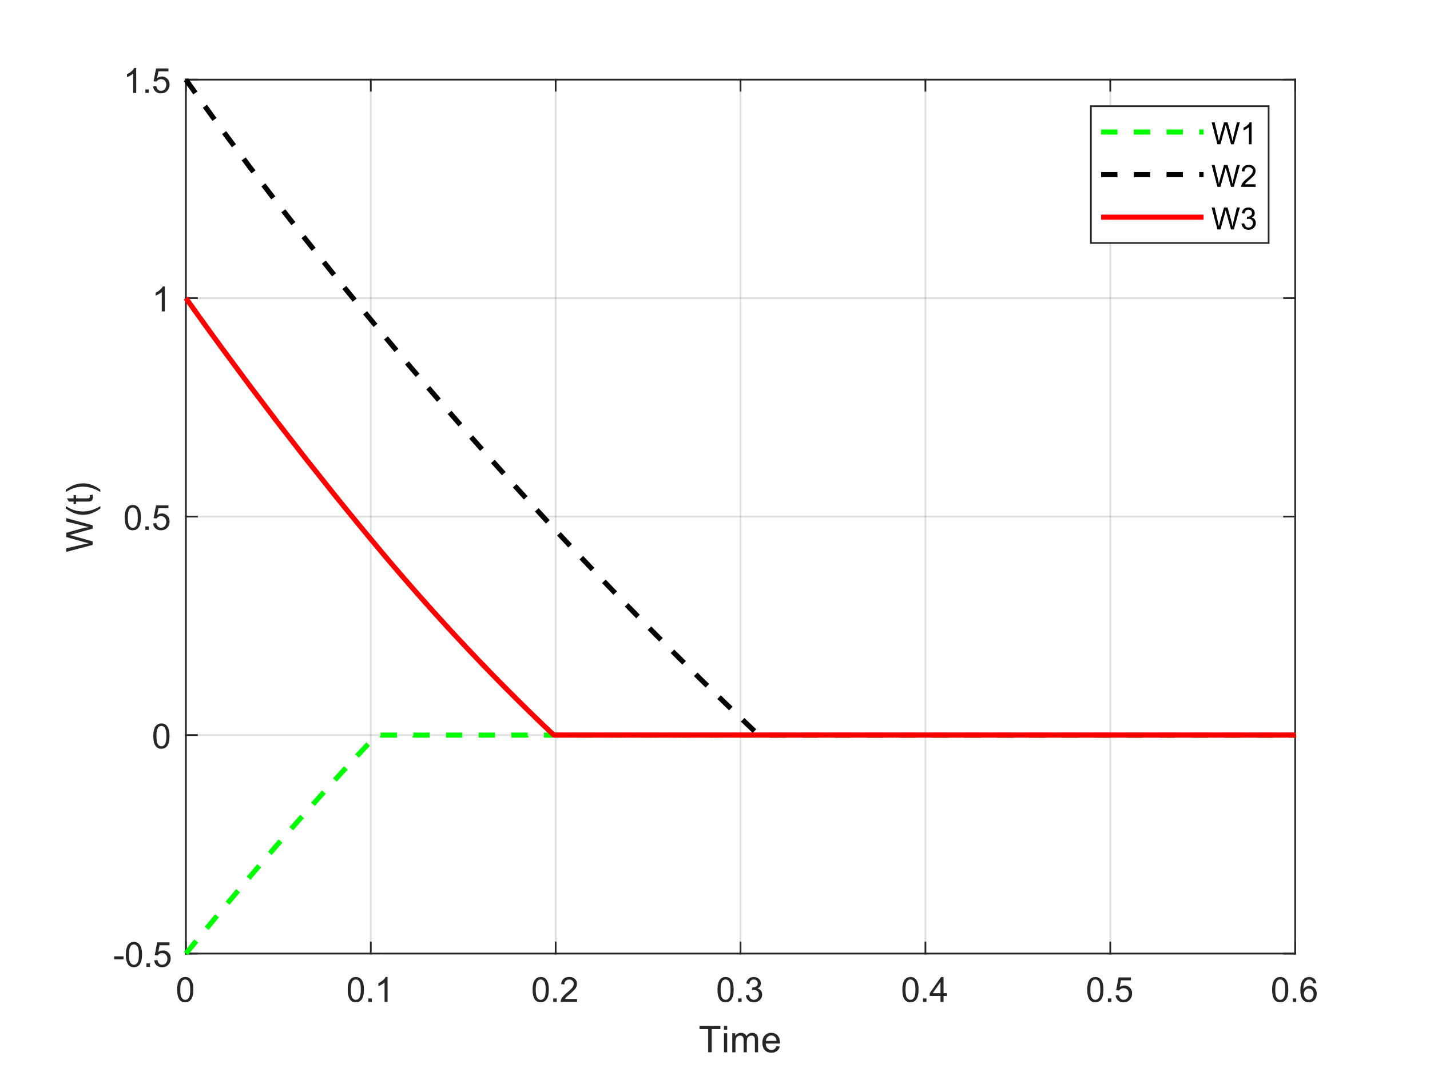



$$β_{i}= γ_{i}=1$$
$$α_{i}=3$$
$$α_{i}= γ_{i}=1$$
$$β_{i}=3$$
$$α_{i}= β_{i}=1$$
$$γ_{i}=3$$

Slide 34
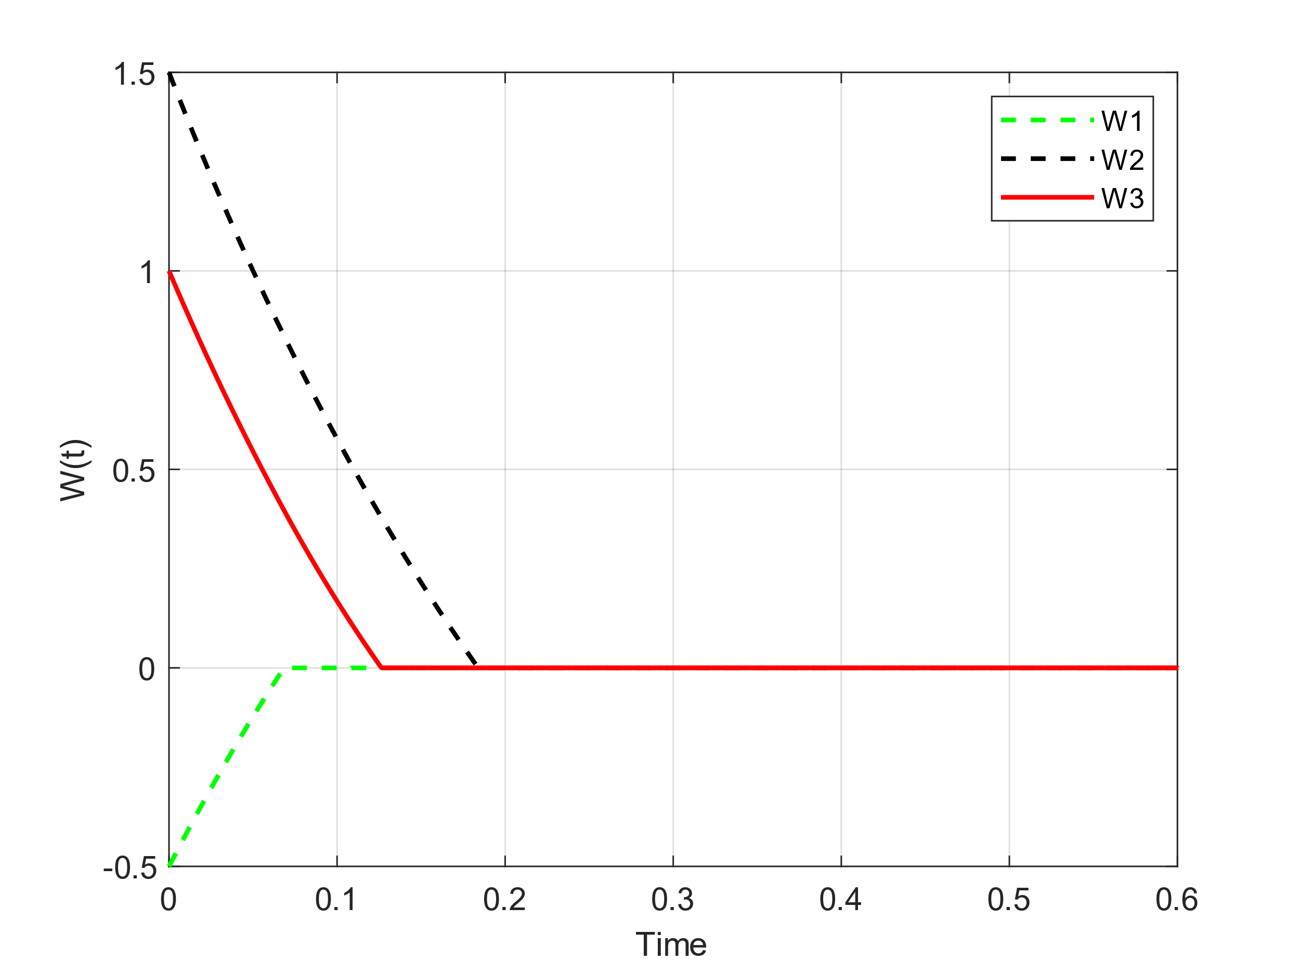

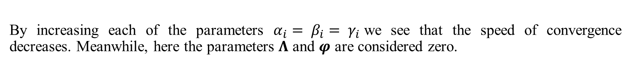
$α_{i}= β_{i}= γ_{i}=$3
$$Λ= φ=0$$
By increasing each of the parameters $α_{i}= β_{i}= γ_{i}$we see that the speed of convergence decreases. Meanwhile, here the parameters 𝚲 and 𝝋 are considered zero.

Slide 35
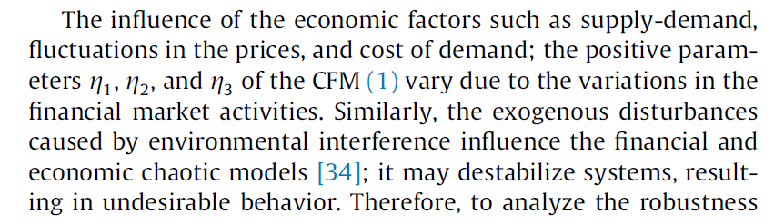
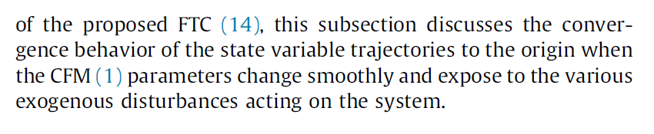

Slide 36





$$φ=0.3$$
$$α_{i}= β_{i}= γ_{i}=0.5$$

